Slide 1

Delivering Digital
Services
Welcome
Presented By: Abigail Smith
Date: August 26, 2014

Slide 2

Welcome!
“Delivering Digital Services”
Notes:
Theme - Delivering Digital Services
Our theme this year is focused on our need to integrate our information to meet the needs of the digital ATM

Slide 3
Agenda
3 information exchange model discussions
SWIM Presentations and Demonstrations
Themes:
  Future Available Services
  Ontology/ Semantics
  Digital Services Vision
Notes:
3 information exchange model discussions
AIXM, WXXM, FIXM
SWIM Presentations and Demonstrations
Themes:
Future Available Services
Ontology/ Semantics
Digital Services Vision
Thank You:
We couldn’t pull off this conference without the speakers who are:
Sharing their expertise, lessons learned, and best practices with us; and
Providing a peek in the future
We are:
1) Providing the latest information on AIXM, WXXM, & FIXM; and
2) continuing our breakout sessions for AIXM, WXXM & FIXM to allow subject matter experts and stakeholders in each of these information exchange areas to go into more detail than the conference setting permits and work out any issues in development and implementation.
IN ADDITION, this year we are combining our NOTAM Industry Day with our Information Exchange Conference. We are doing this to ensure as many as possible can participate by combining our resources and hopefully providing justification for more of you to travel to this event – given the severe economic environment we are all facing.

Slide 4


Participants
Thank you all for coming!
Statistics:
  Registered: 400+
  15+ Countries Represented
Notes:
We are pleased to have so many participants are attending and from so many countries…. And we thank you for coming…
+ 400 participants registered this year
We believe these statistics stress the importance of our topics and support our attempts to integrate the numerous and diverse set of methods, practices, and technologies needed to support the global air traffic management system.
This conference is geared to:
Inform and support this collaboration,
Address issues and garner support for their resolution, and
Expand our view by presenting topics concerning emerging trends.

Slide 5
Exhibitors
Thanks to all our Exhibitors!
Statistics:
  Number registered: 18
Visit them in the Science Center and…
Don’t forget the Lightning Rounds this afternoon
Notes:
We also need to thank all our exhibitors for supporting this conference through sharing their knowledge and products that will lead to way to meet the information demands of the future ATM systems
18 exhibiters registered this year. They are located in the Science Center and we encourage you to check out their offerings today and tomorrow.
There will also be a lightening round event this afternoon for our exhibitors to enlighten us as to what they are developing or are offering to support the our future requirements.

Slide 6
Keynote Speakers
A special Thank You to our Keynote Speakers:
Thursday – Steve Bradford, Chief Scientist for architecture and NextGen Development
Wednesday - Joel Morin, IATA
Today – Teri Bristol, FAA Chief Operating Officer
Notes:
We have keynote speakers EACH DAY to kick off our discussions.
Josh – Need your words here –
Don’t really know exactly what these folks do

Slide 7
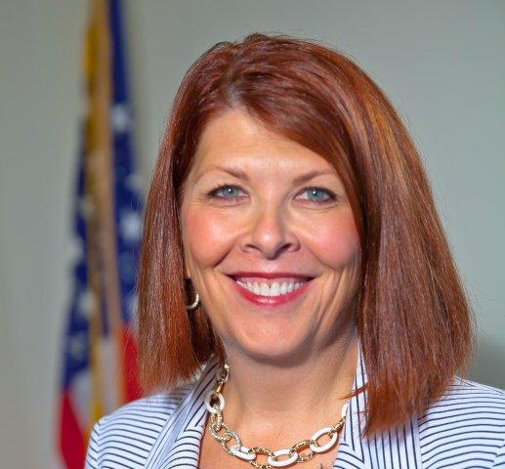
Keynote Speaker for today:
Teri Bristol
FAA Chief Operating Officer

Slide 8
Delivering Digital
Services

