Slide 1
Specification and Validation of Navigation Data Business Rule
Yauwu Tang
AFLCMC/HBAG (MITRE)
29 August 2013
Distribution Statement A: Approved for public release; unclassified; unlimited distribution
Case Number: MITRE 13-2522 and AFLCMC 66ABG-2013-0241.

Slide 2
Introduction
ARINC-424 provides civil standards for preparation of navigation databases (NavData); NavData loaded into Flight Management Systems (FMS)
  ARINC-424 includes data base schema and business rules
AIXM is next generation civil navigation data standard
  AIXM schema provides syntax rules but not business rules
Free format business rule specifications are error prone (imprecise and ambiguous)
Formal machine readable/executable method to specify business rules defined in ARINC 424 and validate data using AIXM syntax rules will:
  Ensure precise and unambiguous business rule specification
  Ensure consistent data validation at all stages of data chain process

Slide 3
Introduction (concluded)
Schematron Standard selected from the following candidates
  SBVR (Semantic Business Vocabulary and Business Rules)
    A formal natural language to specify business rule
    Relative easy to use
    Adapted by Eurocontrol
    But it is not machine readable and executable
  XML Schema Version 1.1
    Provide limited assertion validation (borrowed from Schematron)
  Schematron
    Provide “assertion” and “report” validation rules for a given “context”
      Human and machine readable
      Can be enhanced with human readable descriptions
    Provide free format text on failed assertion and successful report
      Enable domain-specific diagnostic (error) messages
    Human readable descriptions can be extracted and shown to subject matter expert for review
    Provides pointer from implementation to requirement (i.e., traceable requirements)

Slide 4
Overview
This demonstration shows how Schematron can be used to implement and validate ARINC 424 business rules for terminal procedures using AIXM syntax rules
  Schematron is an ISO standard lan­guage for making as­ser­tions about the pres­ence or ab­sence of pat­terns in XML doc­u­ments
Technical Approach
  Using XSLT to embed all data
  Using “Context” to specify applicable data elements
  Using XPath 1.3 for math calculation including trigonometry
ARINC 424 rules analyzed
  Schematron could be used to validate most ARINC-424 business rules
Five business rules from ARINC 424 Attachment 5 will be demonstrated in this presentation

Slide 5
Technical Approach
Embedding all child data
  Use XSLT to embed child data into the parent data file
  Allow Schematron to access children data directly
  Do not need Schematron to find child data using xlink
Using “Context” to specify rules for determining applicable data elements
Using “Assert” and “Report” to describe rules
  Check existence of attributes, value of attributes, counts of attributes etc.
  Present customized text and variable values to describe errors
Using XPath 3.0 for math calculation including trigonometry
  Use XPath variables to perform math calculations
  Evaluate XPath variables in “Assert” and/or “Report” for validation

Slide 6
ARINC 424 Business Rule Analysis
ARINC 424.19 Attachment 5 contains business rules for terminal procedures
Each business rule is analyzed to determine criteria for applicable condition
  Applicable condition categorized based on the coding technique for the criteria
Each business rule is analyzed to determine the nature of validation
  Type of validation: Existence of attributes, Value of attributes, Logic state of attributes, Counts of attributes
  Involved elements/attributes: Can they be reached via sibling relationship?
Sample business rules coded and verified

Slide 7
Organization of Schematron Rules
More than one thousand rules will be needed for AIXM
  Need a way to organize them
Schematron Standard organizes rules in following hierarchy:
  Directory
  Subdirectory
  Files
  Patterns
  Rules
  Assertion/Report
Directory, Subdirectory, and Files allow organization of rules based on domain application and usage
Attributes on Patterns, Rules, and Assertion/Report will allow us to add additional information for
  Reference to requirements
  Add additional natural language descriptions (such as Semantic Business Rule Vocabulary (SBVR))

Slide 8
Demonstration
Five business rules from ARINC 424 Attachment 5
  Demo 1: Validate Start/End Leg Type
  Demo 2: Leg Sequence
  Demo 3: Required Fields for a Leg
  Demo 4: Non-Precision Approach Procedure
  Demo 5: Entry and Exit an RF Leg in Tangent
Rules for Demo 1-3 are in AIXM 5.1 Business Rules
Use AIXM sample data from AIXM wiki
Use Oxygen with Saxon-EE 9.4.0.6 Schematron Validator
Definition of Leg Types can be found in ARINC 424.19 Attachment 5

Slide 9
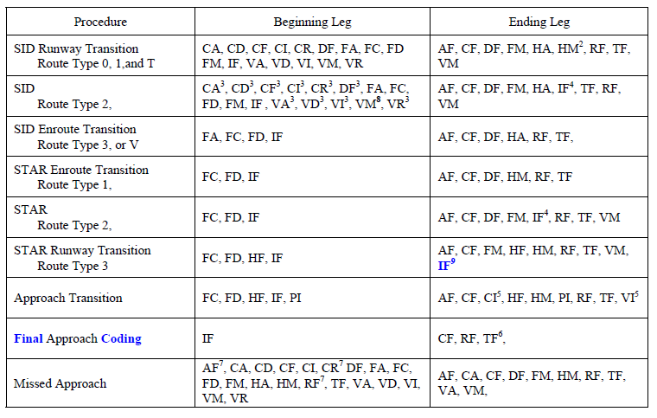
Demo 1: Validate Start/End Leg Type
ARINC 424.19 Attachment 5 Section 1.2

Slide 10
Demo 1: Validate Start/End Leg Type
(Sample Schematron Code)
<sch:rule context="aixm-5.1:flightTransition [aixm-5.1:ProcedureTransition/aixm-5.1:type eq 'APPROACH']">
<sch:assert test="./aixm-5.1:ProcedureTransition/aixm-5.1:transitionLeg[1]//aixm-5.1:legTypeARINC = ('FC', 'FD', 'HF', 'IF', 'PI') and
./aixm-5.1:ProcedureTransition/aixm-5.1:transitionLeg[last()]//aixm-5.1:legTypeARINC = ('AF', 'CF', 'CI', 'HF', 'HM', 'PI', 'RF', 'TF', 'VI')">
ARINC Specification 424, Attachment 5, Section 2.1,
Beginning and Ending Leg Types:
If the transition is an Approach Transition
then the beginning leg must be one of
FC, FD, HF, IF, PI and the end leg must
be one of AF, CF, CI, HF, HM, PI, RF, TF, VI.
</sch:assert>
</sch:rule>

Slide 11
Demo 1: Validate Start/End Leg Type
Test Data
  One Instrument Approach Procedure
    One Final Flight Transitions
      Final Legs: CF, CF
      Missed Approach legs: VA, VI, CF
    Three Approach Flight Transitions
      Approach Transition 1: CF, VI, CF
      Approach Transition 2: IF, VI, CF
      Approach Transition 3: IF, VI, CF
Test Scenario
  Run Schematron validation and expect two errors
    CF Legs can not be the Start Leg of a transition
  Fix error (Change 1st legs from CF to IF)
  Re-run Schematron validation, no more errors

Slide 12
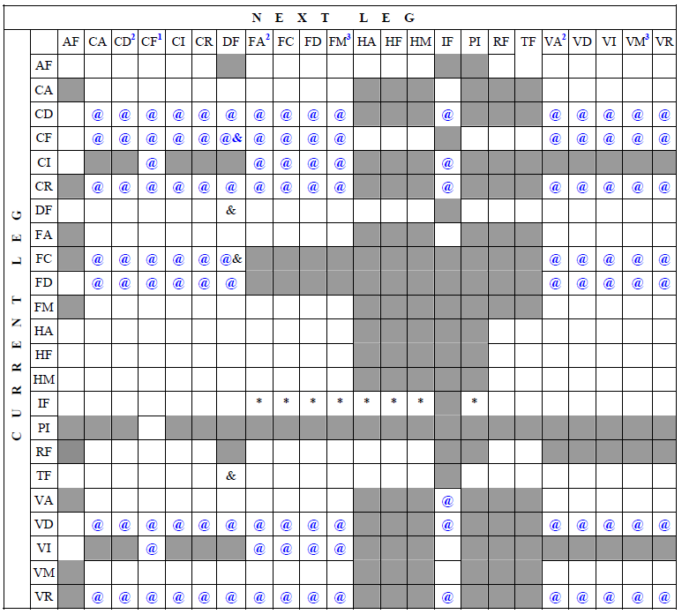
Demo 2: Leg Sequence
ARINC 424.19 Attachment 5 Section 1.3

Slide 13
Demo 2: Leg Sequence
Sample Schematron Code
<sch:rule context="aixm-5.1:transitionLeg [.//aixm-5.1:legTypeARINC eq 'VI'][following-sibling::aixm-5.1:transitionLeg]">
<sch:assert test="following-sibling::aixm-5.1:transitionLeg[.//aixm-5.1:legTypeARINC = ('AF','CF','CF','FA','FC','FD','FM','IF')]">>
If the current leg is VI then the next
leg must be one of AF,CF,FA,FC,FD,FM,IF
</sch:assert>
</sch:rule>

Slide 14
Demo 2: Leg Sequence
Test Data
  One Instrument Approach Procedure
    One Final Flight Transitions
      Final Legs: IF, CF
      Missed Approach legs: VA, VI, CF
    Three Approach Flight Transitions
      Approach Transition 1: IF, VI, CD
      Approach Transition 2: IF, VI, CF
      Approach Transition 3: IF, VI, CF
Test Scenario
  Run Schematron validation and expect one errors
    VI can not be followed with CD
  Fix error (Change Leg CD to CF)
  Re-run Schematron validation, no more errors

Slide 15
Demo 3: Required Fields for a Leg
ARINC 424.19 Attachment 5 Section 1.5

Slide 16
Demo 3: Required Fields for a Leg
Sample Schematron code
<sch:rule context="aixm-5.1:theSegmentLeg [.//aixm-5.1:legTypeARINC = ('CA', 'CD', 'CI', 'CR', 'VA', 'VD', 'VI', 'VR')]">
<sch:assert test="not(.//(aixm-5.1:startPoint,aixm-5.1:endPoint)//aixm-5.1:pointChoice_fixDesignatedPoint//aixm-5.1:designator)">
These legs: CA, CD, CI, CR, VA, VD, VI, VR
must not have a Waypoint Identifier in
either their start point or end point.
</sch:assert>
</sch:rule>

Slide 17
Demo 3: Required Fields for a Leg
Test Data
  One Instrument Approach Procedure
    One Final Flight Transitions
      Final Legs: IF, CF
      Missed Approach legs: VA, VI (w WP ID), CF
    Three Approach Flight Transitions
      Approach Transition 1: IF, VI (no WP ID), CF
      Approach Transition 2: IF, VI (no WP ID), CF
      Approach Transition 3: IF, VI (no WP ID), CF
Test Scenario
  Run Schematron validation and expect one errors
    VI Leg in Missed Approach has a WP ID
  Fix error (Remove WP ID)
  Re-run Schematron validation, no more errors

Slide 18
Demo 4: Non-Precision Approach Procedure
ARINC 424.19 Attachment 5 Section 8.1.1: For approach procedures without an electronic glide slope, the Final Approach Fix will be that designated by government source. If no FAF is established in the government source, one will be computed according to Rule 6.2.5.3 of this attachment. The fix, whether published or established, must carry the Final Approach Fix Waypoint Description code of “F” in position four of that code field. Note that only one record in a coded approach procedure can carry the “F” in position four of the Waypoint Description. Altitudes for this fix are coded in accordance with Rule 6.2.10.1 of this attachment.
Schematron Rules: For Instrument Approach Procedure and Final Flight Transition, there should be one and only one FAF point at final legs

Slide 19
Demo 4: Non-Precision Approach Procedure
(Sample Schematron Code)
<sch:rule context="aixm-5.1:InstrumentApproachProcedure [.//aixm-5.1:approachType = ('ASR','ARA','ARSR','LDA','LDA_DME‘, 'LOC‘,'LOC_BC','LOC_DME','LOC_DME_BC','NDB','NDB_DME','SDF','TLS','VOR','VOR_DME')]">
<sch:assert test="count(.//aixm-5.1:flightTransition[./aixm-5.1:ProcedureTransition/aixm-5.1:type eq 'FINAL']//(aixm-5.1:FinalLeg | aixm-5.1:IntermediateLeg | aixm-5.1:InitialLeg)//aixm-5.1:role[. eq 'FAF']) eq 1">
ARINC Specification 424, Attachment 5, Section 8.1.1:
For approach procedures without an electronic
glide slope, the Final Approach Fix ... must carry
the Final Approach Fix Waypoint Description code of "F"
in position four of that code field.
Alternatively: For approach procedures without an
electronic glide slope, the final transition
must have a final leg with a final approach fix.
These procedures do not have an electronic glide slope:
ASR, ARA, ARSR, LDA, LDA_DME, LOC, LOC_BC,
LOC_DME, LOC_DME_BC, NDB, NDB_DME, SDF, TLS,
VOR, VOR_DME
</sch:assert>
</sch:rule>

Slide 20
Demo 4: Non-Precision Approach Procedure
Test Data
  One Instrument Approach Procedure
    One Final Flight Transitions
      Final Legs: IF (No FAF), CF (No FAF)
      Three Missed Approach legs: VA, VI, CF
    Three Approach Flight Transitions
      Approach Transition 1: IF, VI, CF
      Approach Transition 2: IF, VI, CF
      Approach Transition 3: IF, VI, CF
Test Scenario
  Run Schematron validation and expect one errors
    No FAF at both final legs
  Fix error (Change first CF leg from “no FAF” to “FAF”)
  Re-run Schematron validation, no more errors

Slide 21
Demo 5: Tangent to and from RF Leg
ARINC 424.19 Attachment 5 Section 8.7.3: The track in the transition must be tangent to the arc
Schematron Rules: For Instrument Approach Procedure, an RF leg is preceded with a TF leg and followed with another TF leg, then
  Preceding TF leg must be perpendicular with the line from the end point of the TF leg to center of the RF arc
  The line from End point of the RF leg to the center of the RF arc must be perpendicular to the following TF leg
RF
TF
TF
Arc Center

Slide 22
Demo 5: Tangent to and from RF Leg
(Sample Schematron Code)
<sch:pattern id="RF-leg" see="ARINC specification 424-18, ???">
<sch:rule context="aixm-5.1:InstrumentApproachProcedure//aixm-5.1:flightTransition//aixm-5.1:transitionLeg [.//aixm-5.1:legTypeARINC eq 'TF'][following-sibling::aixm-5.1:transitionLeg[1][.//aixm-5.1:legTypeARINC eq 'RF']][following-sibling::aixm-5.1:transitionLeg[2][.//aixm-5.1:legTypeARINC eq 'TF']]">
- - - - - - - - - - - -
<sch:let name="Leg1-law-of-cosine-distance" value="math:acos((math:cos($Leg1-from-lat-radians) * math:cos($Leg1-to-lat-radians)*math:cos((-1*$Leg1-to-lon-radians) - (-1*$Leg1-from-lon-radians))) + (math:sin($Leg1-from-lat-radians)*math:sin($Leg1-to-lat-radians))) * $Earth-radius-NM" />
<sch:let name="Leg1-a" value="math:pow(math:sin($Leg1-dLat div 2),2 ) + math:cos($Leg1-from-lat-radians) * math:cos($Leg1-to-lat-radians) * math:pow(math:sin($Leg1-dLon div 2),2)" />
<sch:let name="Leg1-c" value="2 * math:atan2(math:sqrt($Leg1-a),math:sqrt(1 - $Leg1-a))" />
<sch:let name="Leg1-Haversine-distance" value="$Leg1-c * $Earth-radius-NM" />
<sch:let name="Leg1-Bearing-raw" value="(math:atan2(math:sin($Leg1-to-lon-radians - $Leg1-from-lon-radians) * math:cos($Leg1-to-lat-radians),(math:cos($Leg1-from-lat-radians) * math:sin($Leg1-to-lat-radians)) - (math:sin($Leg1-from-lat-radians) * math:cos($Leg1-to-lat-radians) * math:cos($Leg1-to-lon-radians - $Leg1-from-lon-radians))))" />
<sch:let name="Leg1-Bearing" value="($Leg1-Bearing-raw + (2 * math:pi())) mod (2*math:pi())" />
<sch:let name="Leg1-Bearing-degrees" value="$Leg1-Bearing * 180 div math:pi()" />
- - - - - - - - - - - - -
<sch:assert test="($Difference1 gt (90-$delta) and $Difference1 lt (90+$delta)) or ($Difference1 gt (270 - $delta) and $Difference1 lt (270 + $delta)) or
($Difference1 gt (-90 - $delta) and $Difference1 lt (-90 + $delta)) or
($Difference1 gt (-270 - $delta) and $Difference1 lt (-270 + $delta))">
For an RF Leg, the previous leg must be tangent to the arc.
</sch:assert>
</sch:rule>
Listed Code for illustration purpose, not complete

Slide 23
Demo 5: Tangent to and from RF Leg
Test Data
  One Instrument Approach Procedure
    Approach Flight Transitions
      Leg 1: TF (34.606319, -118.430708)
      Leg 2: TF (34.543858, -118.751711)
      Leg 3: RF (34.356694, -118.8812920)
      Arc Center (34.399844, -118.51055)
      Leg 4: TF (34.165078, -118.810819)
Test Scenario
  Run Schematron validation and expect one error
  Fix error (Change Arc Center from -118.51055 to -118.71055)
  Re-run Schematron validation, no more error

Slide 24
Conclusion
Benefits of using Schematron for AIXM business rules
  It is precise
  It can be used to validate actual data (no software development)
  It is understandable by domain expert
    Can be enhanced with embedded SBVR or plain text rules

Slide 25
Recommendation
Recommend to include as part of AIXM business rules
  Start with ARINC 424 Rules

