Slide 1

Integrating information towards Digital ATM
AIXM Business Rules developments
Date: August 26, 2013

Slide 2
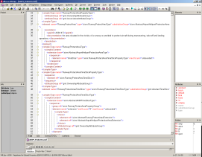
Validation of AIXM 5.1 data
AIXM 5.1
UML
AIXM 5.1
XSD
- Does the data make sense?
- Is it compliant with international standards ?
- Do I respect recommended practices?
- …
=
Syntactic check
Semantic check
- Check the compliance of an XML dataset with the XSD grammar
- Performed by standard XML parsers (e.g. xerxes, MSXML, XMLSpy, etc.)
AIXM 5.1
XML
Business Rules
Airport
features

Slide 3
Use of SBVR
SBVR = (OMG) Semantics of Business Vocabulary and Business Rules
  defines the vocabulary and rules for documenting the semantics of business vocabularies, business facts, and business rules.
It identifies two types of business rules
  Structural rules
  Operative rules
AIXM 5 has adopted this terminology and identifies the following business rules:
  AIXM Structural rules: the enumerations of values (datatypes)
    (Most) coded already in the AIXM schema
  AIXM Operative rules: rules extracted from official documents (ICAO Annexes), minimum data rules, consistency rules, recommended practices, coding rules…
    These are the rules that we try to capture as part of the current BR project

Slide 4
SBVR for AIXM BR
Structural rules examples (that are not captured as data types):
  “Each [...].lowerLevel that has an uom equal to 'FL' should have 2 or 3 digits.”
Operative rules examples:
  “Each AirportHeliport.ARP must have horizontalAccuracy and AirportHeliport.ARP.horizontalAccuracy should be at most 1sec”
  “Each DepartureLeg that has a speedLimit must have a speedReference”
  “Each ElevatedCurve that has a verticalAccuracy must have an elevation”

Slide 5
SBVR for AIXM
Work in progress
  “Community Project”
    small stakeholder group, mostly industry
    Started in June 2013
    Baseline of 1300 potential rules
      coming from AIXM 4.5 and previous projects (AIXM-ARINC 424 mapping, Digital NOTAM, etc.
      Initial SBVR formulated
    First phase – Airspace and SBVR profile
      Results expected to become public by October 2013

Slide 6
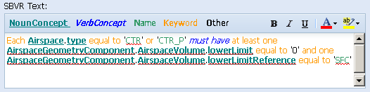
SBVR in AIXM - example
ICAO Annex 11: “If a control zone is located within the lateral limits of a control area, it shall extend upwards from the surface of the earth to at least the lower limit of the control area.”
SBVR equivalent:

Slide 7
Encoding Business Rules
ISO Schematron
Schematron (http://www.schematron.com/)
  is an open language for the validation of XML document…
  …whose specification is standardized (ISO/IEC 19757)
There are 6 basic elements in ISO Schematron: assertion, rule, pattern, schema, namespace and phase.
Notes:
Schematron is a structural based validation language for XML document validation. It combines powerful validation capabilities with a simple syntax and implementation (XML notation) that can be used in an autonomous way or in supplement to other schema languages. It is an open specification standardized by ISO. Several free and open source implementations are available.
Basically, Schematron differs from other schema languages in so far as it is not based on grammars but on the searching of tree patterns in the document. Tree patterns, defined as XPath expressions, are used to specify and declare assertions and to provide user-centred reports about XML documents.

Slide 8
Encoding Business Rules
ISO Schematron
<assert> and <report> elements
  Test attribute
  Simple declarative sentences in natural language
  <assert> used to tag assertions positively
<!-- The assert element matches if test is false -->
<assert test="//designator">
An AirportHeliport shall have a designator.
</assert>
<rule> element
  Used to group assertions
  Has a context: if the context matches, the assertions are tested
<pattern>, <phase>, <schema>: used to logically group rules
Notes:
Assertion elements
A Schematron schema is made of specifying assertions, which are simple declarative sentences in natural language. The <assert> (resp <report>) element is used to tag assertions positively (resp negatively). The assertion elements have a test attribute which is an XPath expression evaluated as a Boolean.
Rule elements
The assertions elements must be grouped within a <rule> element. The <rule> element has a context attribute which contains an XPath expression. Each element in the document for which this XPath expression is true is then used as the context to test the assertions.

Slide 9
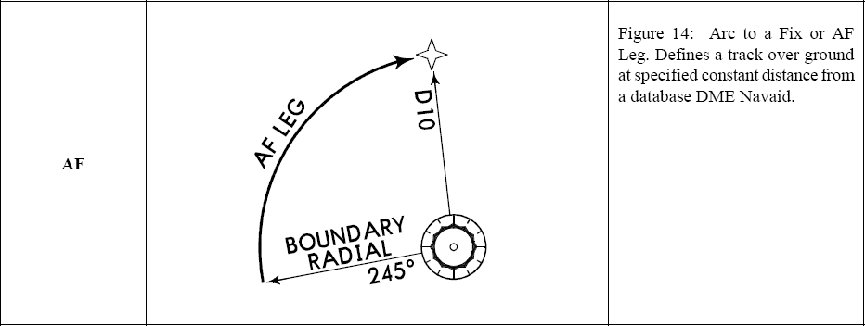
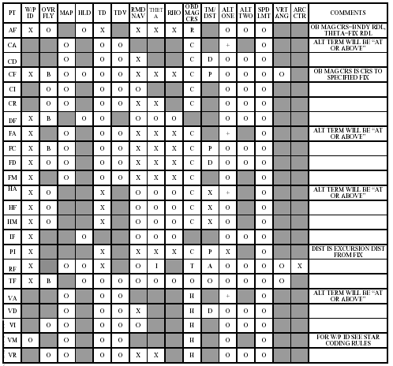
Encoding Business Rules
ISO Schematron
Operational Rule
Translation in SBVR
Each ProcedureTransitionLeg.theSegmentleg that has legTypeARINC equal to AF must have a turnDirection.
<SegmentLeg>
<legTypeARINC>AF</legTypeARINC>
<turnDirection>L</turnDirection>
</SegmentLeg>
<rule id="1"
-> unique identifier of the rule
context="// SegmentLeg[@legTypeARINC='AF'] "
->Defines the conditions of the rule (If attribute SegmentLeg.legTypeARINC= “AF”).
->The rule will be tested if the context is true.
<assert id="1_1"
-> unique identifier of the assertion
test="boolean(@turnDirection)"
-> the logical test to be performed. The “assert” element matches if the logical test returns false (in this case, if the turnDirection is not provided).
Simplified ISO Schematron example
<rule id="1" context="//SegmentLeg[@legTypeARINC='AF'] ">
<assert id="1_1"
test="boolean(@turnDirection)">
</assert>
</rule>

Slide 10
Questions

Slide 11
Contact Information
Eddy Porosnicu (EUROCONTROL)
  eduard.porosnicu@eurocontrol.int
  +32 (2) 729-3326
Diana Young (FAA)
  diana.young@faa.gov
  +1 (202) 385-7445

