Slide 1
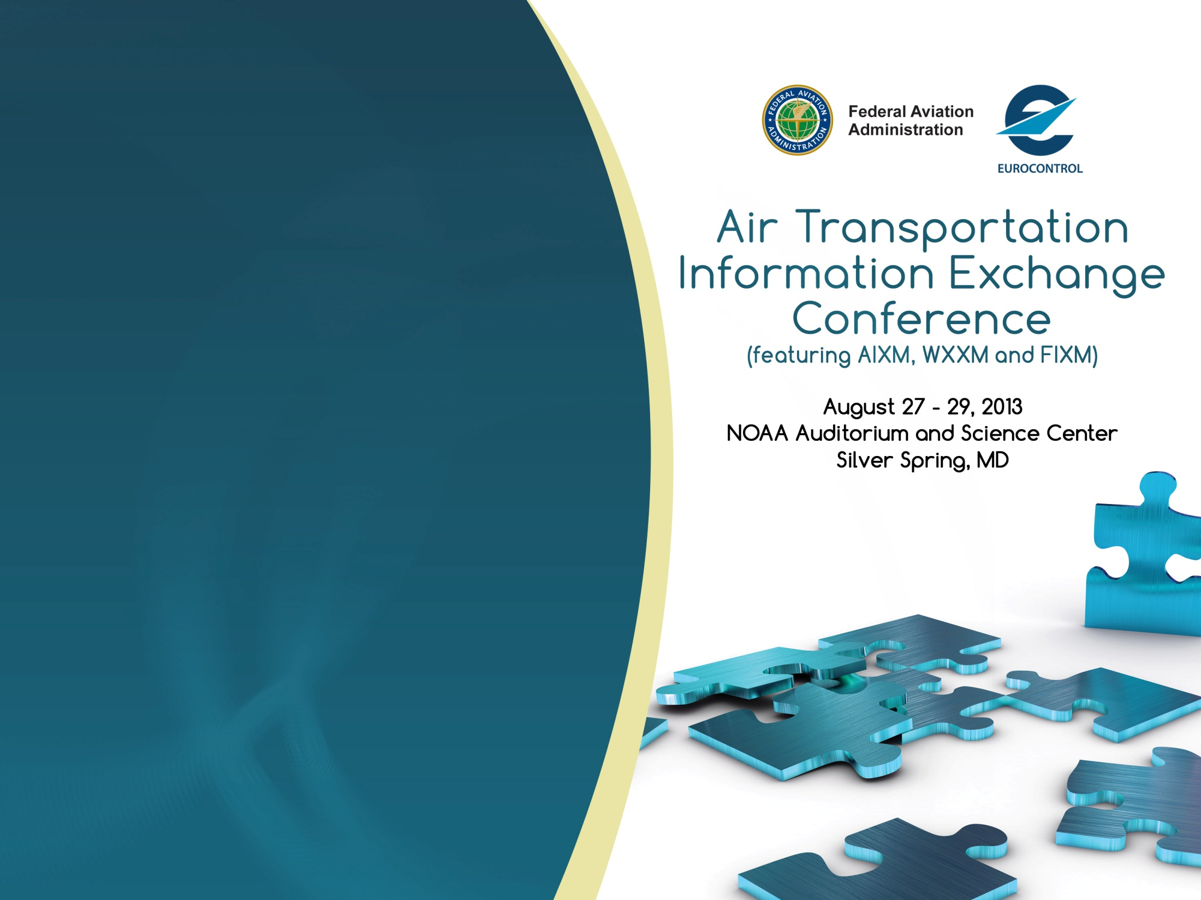
Integrating information towards Digital ATM
AIXM
Break-out Session
Date: August 26, 2013

Slide 2
Proposed agenda
1:45 - 1:50 welcome/introduction
1:50 - 2:20 AIXM Business Rules developments (Eddy Porosnicu, Eurocontrol)
2:20 - 2:50 MITRE work on Business Rules (Yauwu Tang, MITRE)
2:50 - 3:10 short break
3:10 - 3:40 DAFIF in relation with AIXM (Jodi Brainard, NGA)
3:40 - 4:10 AIXM Modularisation Considerations (Katrina Wilson, FAA)
4:10 – 4:30 AIXM Message Granularity (Kevin Lew, CNA)
4:30 - 4:45 FAA AIXM Viewer – new capabilities (Luciad)
4:45 - 5:00 Snowflake ATM Viewer – new capabilities (Snowflake)
5:00 closing

Slide 3
Contact
Diana Young (FAA)
  diana.young@faa.gov
  +1 (202) 385-7445
Eddy Porosnicu (EUROCONTROL)
  eduard.porosnicu@eurocontrol.int
  +32 (2) 729-3326
3

