Slide 1



Maps Engine
Mike Evanoff and Louis Simonen
Google’s FAA Cloud Mapping Dudes

Slide 2

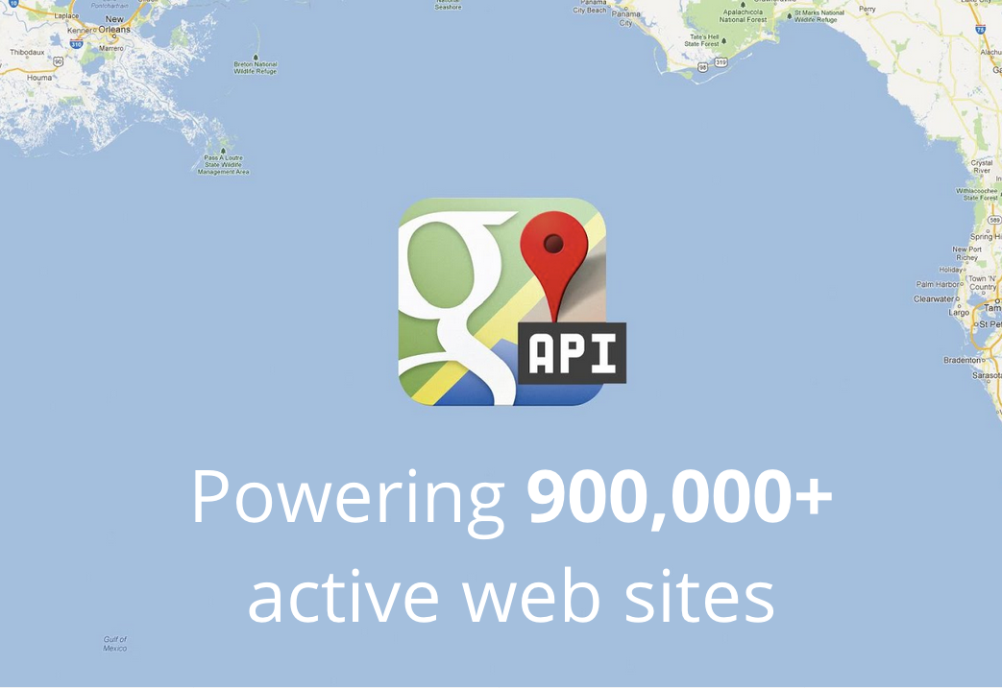
Mapping is now mainstream

Slide 3

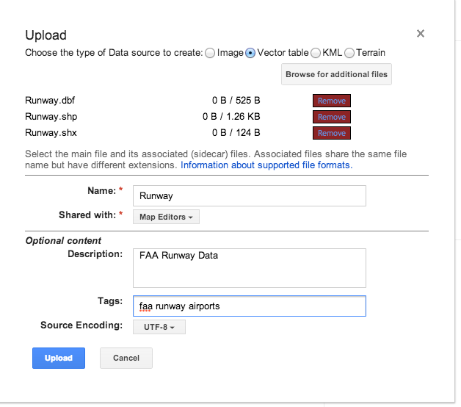
Upload Your Data

Slide 4
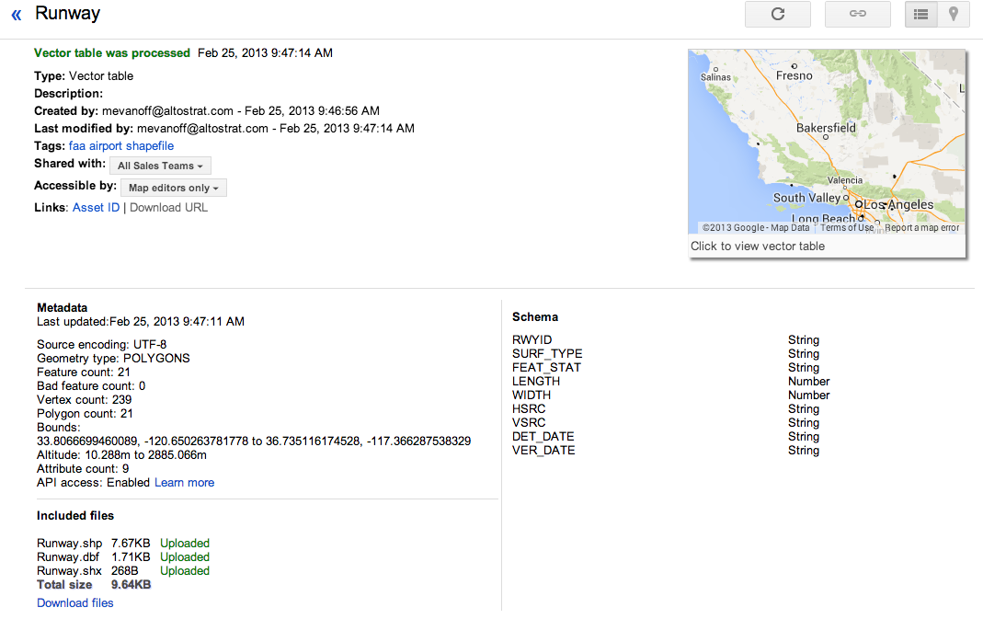
View the Uploaded Data Details

Slide 5
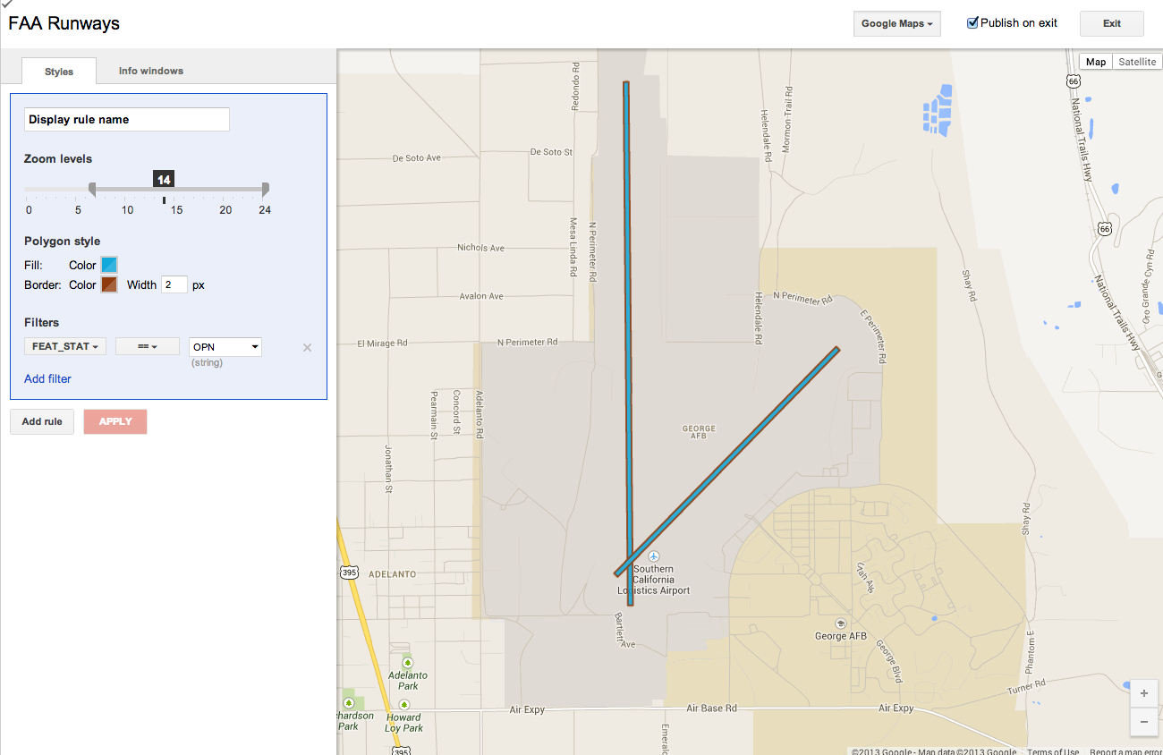
Apply a Style

Slide 6
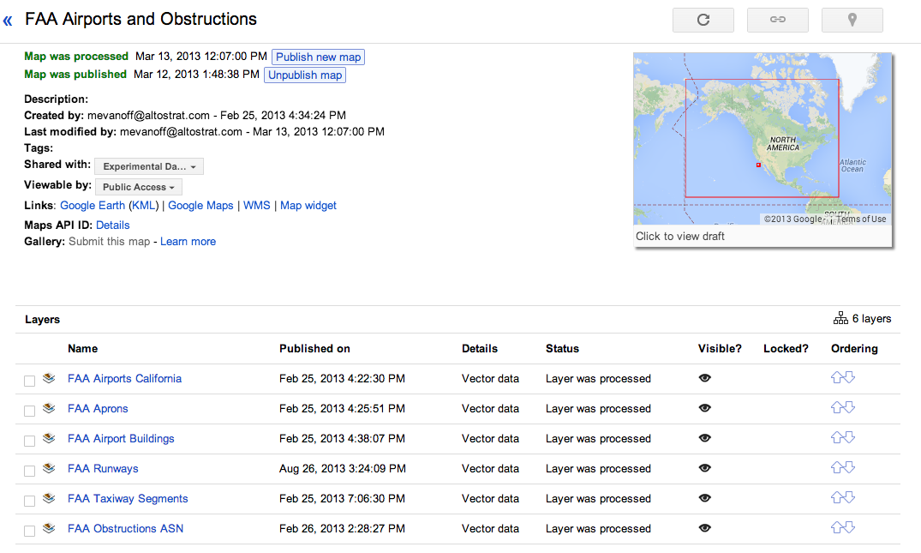
Add Your Layers to a Map

Slide 7

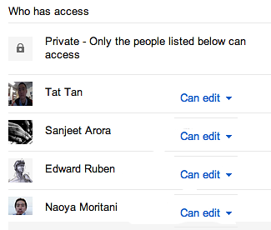

Establish Sharing

Slide 8
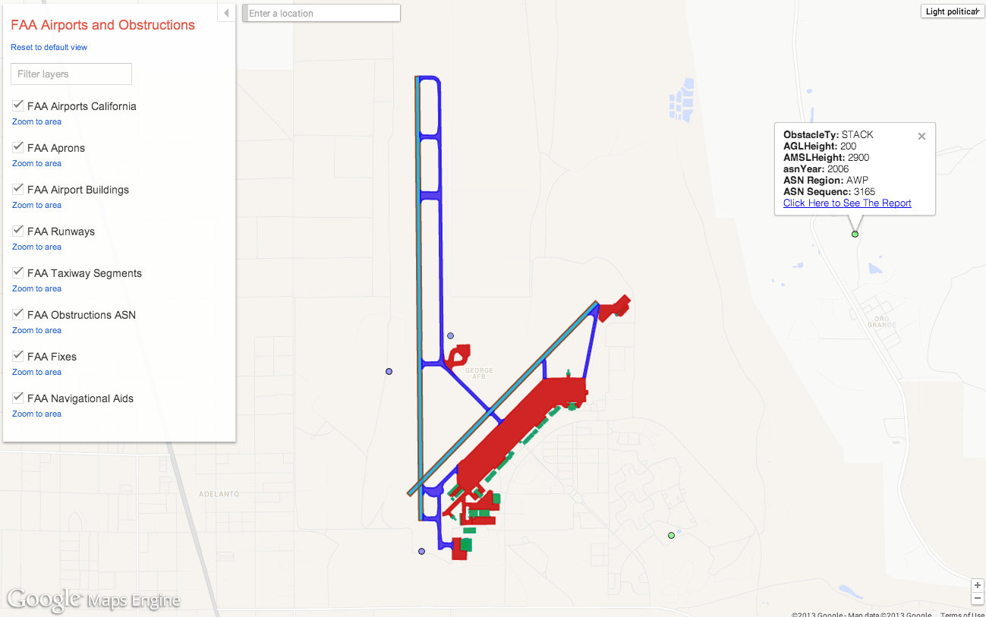
View the Map

Slide 9
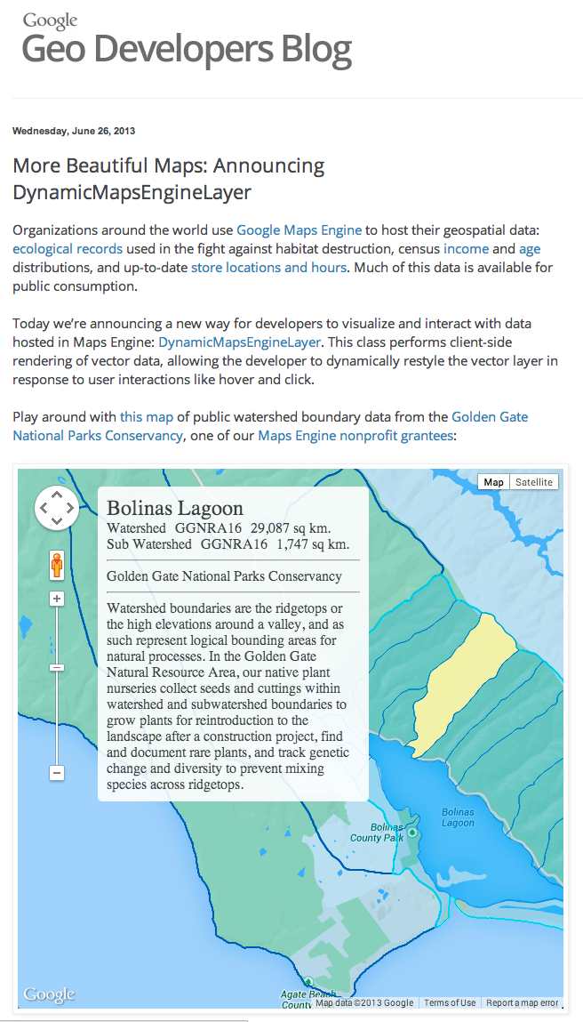
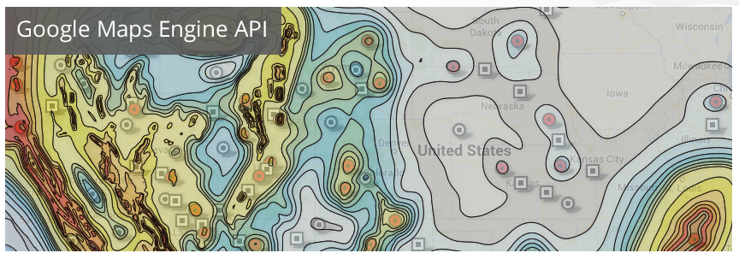
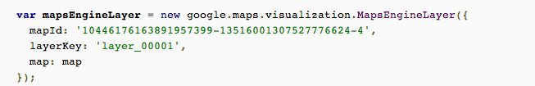
Customize with API access

Slide 10
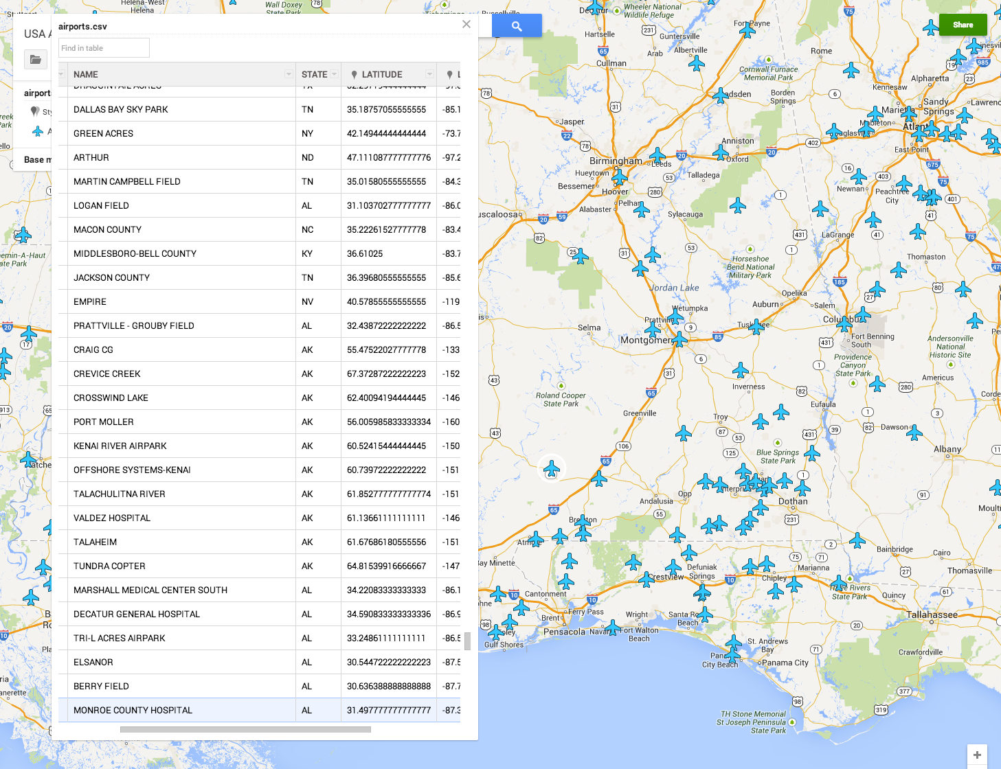
Simple GUI for Adding/Editing

Slide 11
Upload to Google Maps Engine
You Know You’re in the Cloud If …….
You didn't install any operating systems or servers
You don't know (or care) how many cores or servers you have - it just works
Your data is spread across redundant data centers
You can access via browsers, tablets, Mac, PC, iPhone, Android anywhere in the world. 2D 3D WMS
You can collaborate and share across organizations
You leveraged existing robust authentication
Your map can scale easily in case of disaster

Slide 12


What does this mean for business?
Thank you

