Slide 1
Presented by:
Sean Grant
Aeronautical Product Specialist
sgrant@esri.com

Slide 2




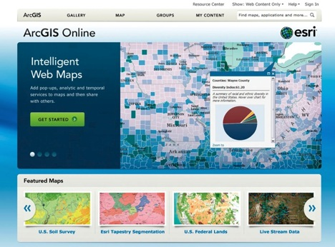








ArcGIS Platform
For creating and sharing intelligent maps and geographic information
For discovering and using maps and geographic information
Cloud/Web
Desktop
Server
Intelligent web maps
Notes:
Fundamentally, our work is about ArcGIS; that's where we focus most of our attention, which we define as a complete system for geographic information. It has clients; web clients; mobile clients; desktop clients; servers; enterprise servers; and increasingly, clients in the cloud and a new dimension called ArcGIS Online.

Slide 3
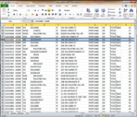

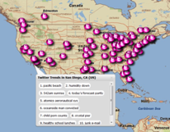

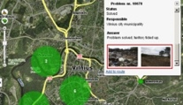
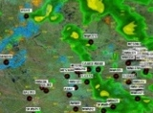




ArcGIS Platform
For creating and sharing intelligent maps and geographic information
For discovering and using maps and geographic information
Enterprise Data
Social Media
Services
Imagery
Sensor
Networks
Maps
Big Data
Notes:
Fundamentally, our work is about ArcGIS; that's where we focus most of our attention, which we define as a complete system for geographic information. It has clients; web clients; mobile clients; desktop clients; servers; enterprise servers; and increasingly, clients in the cloud and a new dimension called ArcGIS Online.

Slide 4
ArcGIS Supports the Enterprise
Knowledge Workers
Executive Access
Public
Engagement
Work
Anywhere
Enterprise
Integration
Web GIS
ArcGIS
Professional
GIS
Making Mapping and GIS
Available Across Your Organization
Notes:
Fundamentally, our work is about ArcGIS; that's where we focus most of our attention, which we define as a complete system for geographic information. It has clients; web clients; mobile clients; desktop clients; servers; enterprise servers; and increasingly, clients in the cloud and a new dimension called ArcGIS Online.

Slide 5
ArcGIS for Aviation
  ArcGIS for Aviation: Charting
    Database Driven Charting
    Centralized Data Management
  ArcGIS for Aviation: Airports
    Focused GIS solution for airports
      Preconfigured Map Products
      400+ Data Quality Checks (Spatial & Non-Spatial)
      Database template

Slide 6



Industry Standards
ICAO Annex 4, 14, 15
AC 150/5300-18B
ADQ
AMDB (DO-272)
ISO 9001
Certified
Compliance
And Leadership
WFS,WMS
AIXM 4.5, 5.x
Notes:
One of the ways we feel we strive as an organization to make you feel safe and secure with your investment is our commitment to industry standards. All development activities and services support are managed with ISO approved processes. We work closely with various ICAO standards and have played a leading role in implementing AIXM as a data exchange format.
Beyond some of the Aeronautical standards we strive to adhere to, ESRI is a key member of OGC and continues to push the envelope with regard to metadata interoperability and standards for data exchange.

Slide 7
Come visit us at our booth!
Twitter: @aerocharts
Email: aero@esri.com
Notes:
Suggestion for ending slide.

