Slide 1


Obstacles
AIXM 5.2 Briefing, 1st of July 2020
Presented by: Wolfgang Scheucher

Slide 2
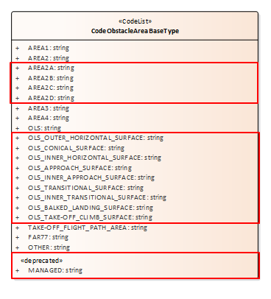
Obstacle area types alignment ICAO (1)
The current model is missing some of the ICAO obstacle areas defined in Annex 15/PANS-AIM, e.g. Area 2a, subtypes of OLS etc.
Proposed Solution:
Add new values to code list CodeObstacleAreaBaseType,
(delete MANAGED)
Notes:
See,https://aixmccb.atlassian.net/browse/AIXM-370
https://aixmccb.atlassian.net/browse/AIXM-203

Slide 3
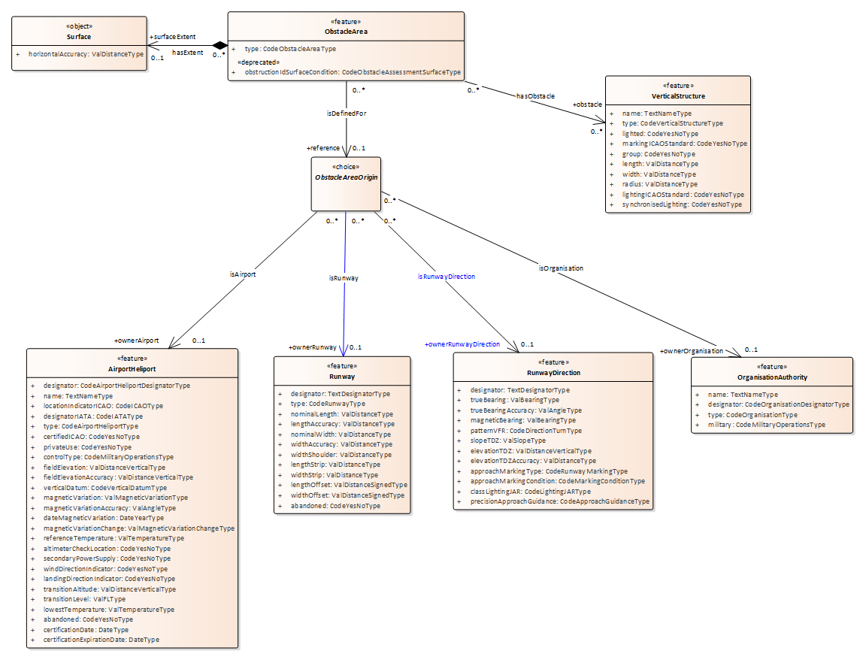
Obstacle area types alignment ICAO (2)
ICAO Area 2a and Area 2c are related to the Runway. In the current model there is no relationship between ObstacleAreaOrigin and Runway class.
Proposed Solution:
Add missing relationship
(Align naming of relationships)

Slide 4
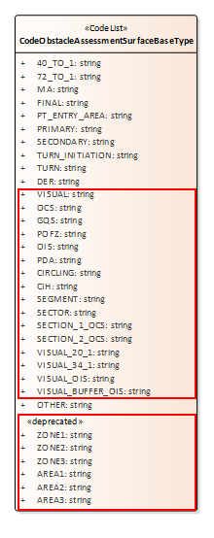
Obstacle area types alignment ICAO (3)
The attribute obstructionIdSurfaceCondition of the ObstacleArea feature is only relevant for the ObstacleAssessementArea
  “An indicator of the type of obstacle assessment surface that obstructing area represents.”
Proposed Solution:
Delete the attribute obstructionIdSurfaceCondition from the ObstacleArea feature.
In addition, the code list values to be updated including additional TERPS surfaces and removing non-procedure design relevant values

Slide 5
Obstacle types review
Comparison was made with
  RTCA/EUROCAE (ED-98, ED-119)
  ICAO Annex 4 Chart Symbols
  AIRM
Several types not present in the AIXM code list for the VerticalStructure.type e.g. AIRPORT_BEACON, BLASTFENCE, BUSH, HANGAR, TERMINAL, WINDSOCK, etc.
Possible Solutions:
  Leave AIXM as it is (use OTHER)
  Add “localType” text attribute
  Add additional types
    Extend CodeVerticalStructureType
    Add a sub-type attribute allowing to refine the primary obstacle type, e.g. BUILDING having subtype CHURCH, MOSQUE, HANGAR, TERMINAL etc; POLE having subtype LIGHTPOLE, WINDSOCK etc.
Notes:
https://aixmccb.atlassian.net/browse/AIXM-280 ,

Slide 6

Arresting Gear association with obstacle
Arresting devices are considered as obstacles and when up can have an impact on the performance calculation.
AIXM allows to encode arresting gear devices, but does not include an association between ArrestingGear and VerticalStructure.
Proposed Solution:
Add a relationship
Notes:
https://aixmccb.atlassian.net/browse/AIXM-282

