Slide 1

Airport / heliport open issues
AIXM 5.2 Briefing, 1st of July 2020
Presented by: Katrina Wilson, FAA

Slide 2
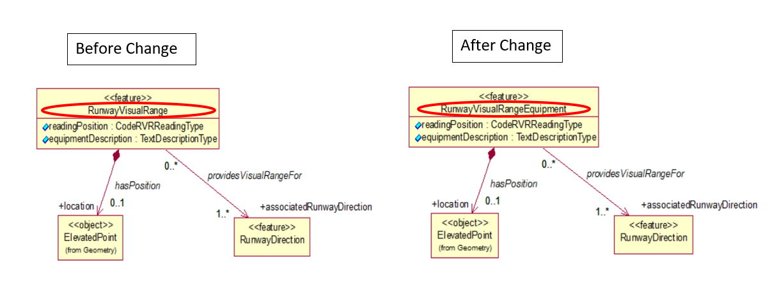
Runway Visual Range Equipment
Rename <<feature>> “RunwayVisualRange” to “RunwayVisualRangeEquipment”.

Slide 3
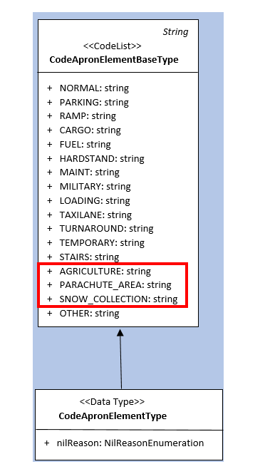
Additional Apron Element types
CodeApronElementBaseType:
AGRICULTURE = “Loading area for agricultural activities.”
PARACHUTE_AREA = “An area supporting parachute activities.”
SNOW_COLLECTION = “Apron area where snow collection from other parts of the airport is acceptable.”

Slide 4
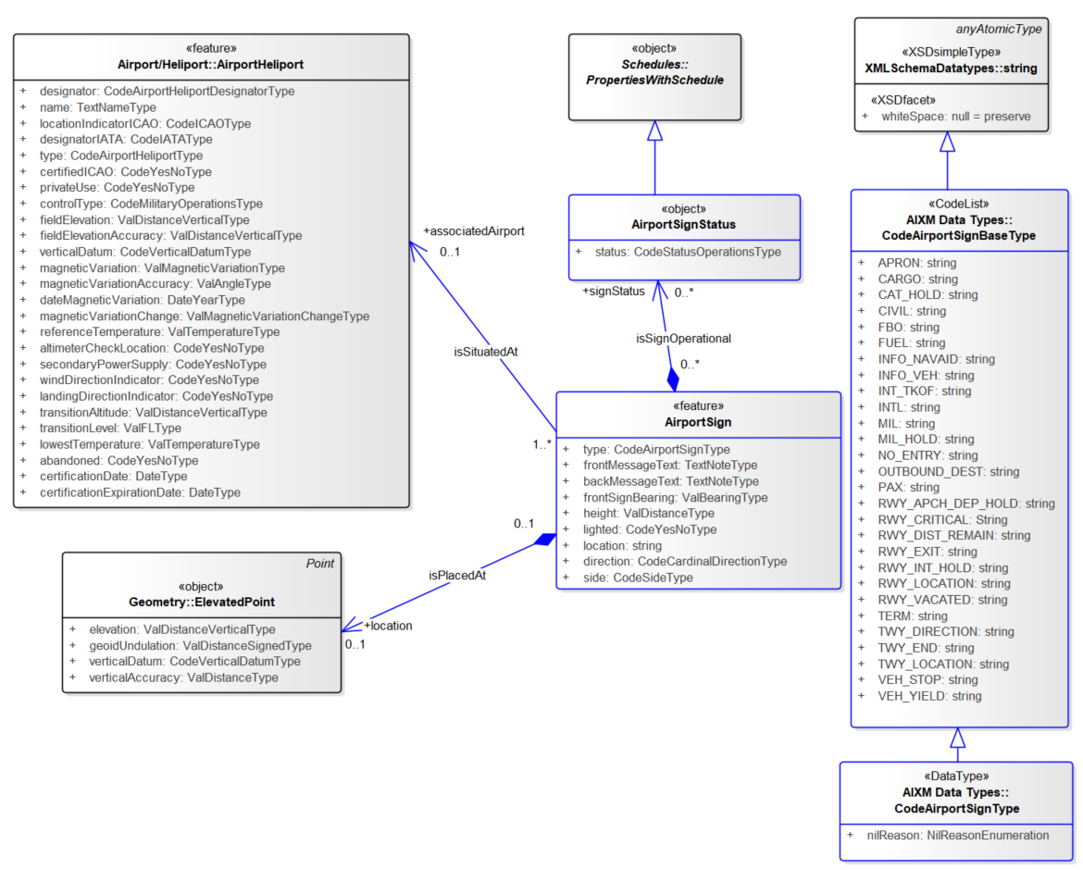
Model for Airport/Heliport signs

