Slide 1
AIXM CCB process
AIXM 5.2 Briefing, 1st of July 2020
Presented by: Suzanne KOPPANEN (FAA)

Slide 2
Agenda
CCB Overview
CCB Process
Examples

Slide 3
AIXM CCB
AIXM Change Control Board
Established based on the ICAO AIS-AIMSG recommendations
Determines the evolution of AIXM
In close contact with the ICAO IMP
CCB process to be aligned with eventual IMP decisions
Reports progress on an annual basis
Membership implies acceptance of the Charter
http://www.aixm.aero/page/governance

Slide 4
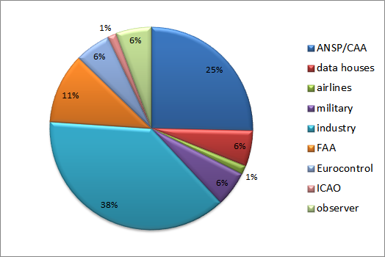
AIXM CCB
Current distribution of members
55 industry partners and organisations including EuroControl, and Federal Aviation Administration (FAA)
http://www.aixm.aero/page/governance
Notes:
Demonstrates distribution of the CCB members
CCB Secretariat and Advisory Board support each other and are made up of members
Details on the AIXM Webpage provided

Slide 5
CCB Process
Problem
Solution
Notes:
In order to effectively apply the provisions of the Charter, a change management process is put in place and supported by the JIRA Tool

Slide 6
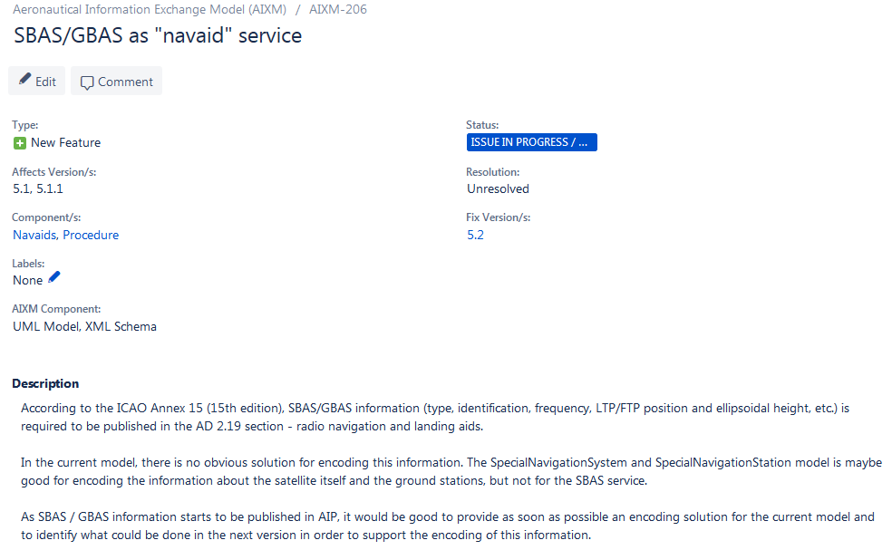
AIXM 5.2 – issue example
Notes:
- Issue submitted by CCB member for review and eventual acceptance

Slide 7
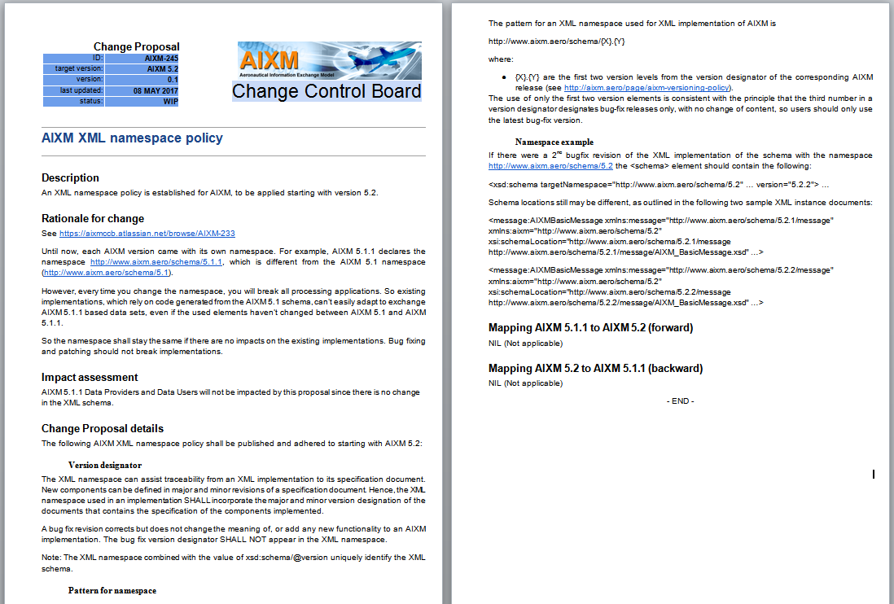
AIXM 5.2 – CP example
Notes:
- Sample of the change proposal before it can be voted on and mapped to AIXM

