Slide 1

Introduction
AIXM 5.2 Briefing, 1st of July 2020
Presented by: Eduard POROSNICU, EUROCONTROL

Slide 2
Practical WEBEX information
… to facilitate this WEBEX as smoothly as possible
This WebEx Event accommodates three types of attendance
  Host (secretary of the meeting and support)
  Panelists (active CCB members who prepared the presentations)
  Participants (anyone else registered for the meeting)
    do not see the participants’ list (to save bandwidth)

Slide 3
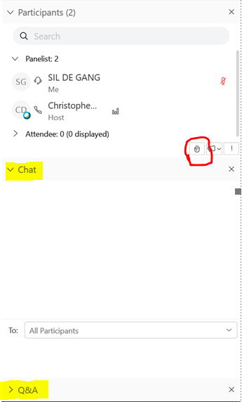


Practical WEBEX information
… to facilitate this WEBEX as smoothly as possible
Code of Conduct for Participants
  You are MUTED by default.
  There will be two Q&A sessions, where you will get the opportunity to ask questions.
    Use the Q&A functions (bottom right of screen) during the event to prepare questions to panelists. Mention AIXM issue number (if applicable).
      These will be answered first during the Q&A sessions
    Use the RAISE HAND function
      Moderators will then unmute you so that you can ask your question.
      Please do lower your hand after being allowed to ask your questions.
    Use the Chat functions (right of screen) to address the host

Slide 4
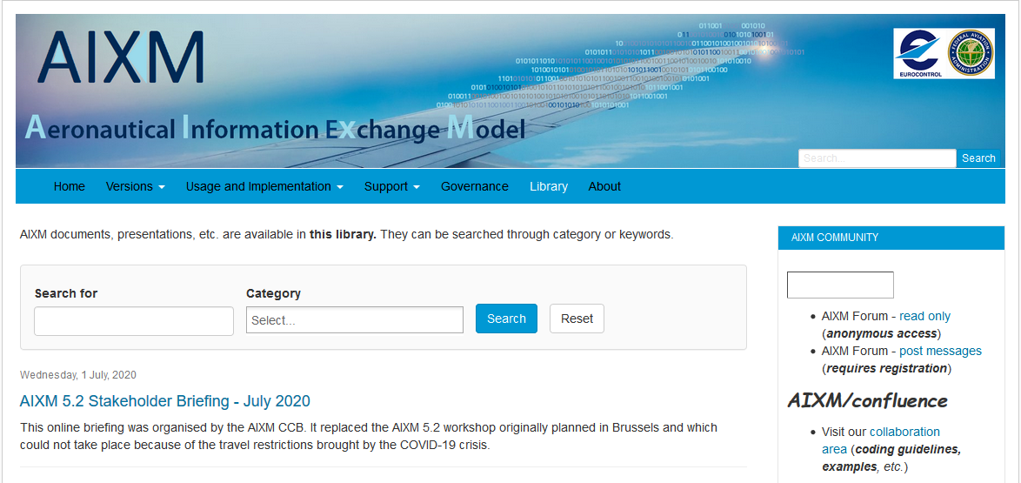
All Presentations will be made available on the AIXM.aero website

Slide 5
Objective
Brief on the development status of the next AIXM 5.2 version
  Already approved change proposals
    Full details available on www.aixm.aero/confluence
    (“AIXM 5.2 Changes” Space)
  Change proposals in preparation
    Selection of key topics
  Summary of other open issues

Slide 6
5.2 – minor (maintenance) version
  No change in fundamentals of the model (use of UML/GML/temporality model)
  High-level objectives (see http://www.aixm.aero/page/governance)
  Interoperability to be ensured at application level
    ICAO digital AIS data sets
      Coordination with ICAO IMP (WG-A)
        5.1.1 -> proposed for the ICAO data sets
        ICAO AIS Manual, vol. 4, will reference AIXM coding guidelines
        See proposed interoperability rules for AIP Data Set
    Other XMs
      Coordination with FIXM and IWXXM CCBs

Slide 7
Agenda
14:00 1) Introduction
14:10 2) AIXM CCB Process
14:20 3) Approved AIXM 5.2 Changes
15:00 1st Q&A Session
15:30 4) Open issues and change proposals in progress
16:10 2nd Q&A Session
16:30 5) Conclusions and next events

