Slide 1
Discussion
Presented by
Eduard Porosnicu, EUROCONTROL

Slide 2
Agenda
Lessons learned – open discussion with the objective to identify
  Technical / operational issues to be addressed in the Digital NOTAM Specification (version 2.0)
    Any input?

Slide 3
Agenda
Lessons learned – open discussion with the objective to identify
  Any need for ‘generic training’, other than what is specific to the tool
    Any input?
    Glossary of terms that are relevant for Digital NOTAM – such as scenario, SAA, etc.
    Transition phase – requires more knowledge about digital NOTAM concepts as compared to later phases when more advanced HMI will be available
      For example, ability to read XML and understand what is right/wrong
    Scope of each scenario – what is supported, what not?
    For example, see https://ext.eurocontrol.int/aixm_confluence/display/public/DNOTAM/Commented+Digital+NOTAM+coding+example

Slide 4
Agenda
Brainstorming – how to encourage the Digital NOTAM implementations around the world
  ICAO Annex 15 (16th edition) – “placeholder” for Digital NOTAM
  ICAO/IMP – NOTAM revision plans
  Digitally enhanced briefing concept (SESAR ePIB) as an end user application based on Digital NOTAM
  Proposed actions

Slide 5
ICAO Annex 15 – 16th edition
…and PANS-AIM (DOC 10066) – 1st edition
Digital data sets
  AIP(en-route), instrument flight procedures, obstacle, airport mapping
5.3.2.3 The AIP data set shall contain the digital representation of aeronautical information of lasting character (permanent information and long duration temporary changes) essential to air navigation.
(PANS-AIM) 5.3.3.1.1, Note 2.— The AIP data set includes relevant AIP Amendment and SUPPs information.
6.3.3.2 Permanent changes and temporary changes of long duration (three months or longer) made available as digital data shall be issued in the form of a complete data set or a subset that includes only the differences from the previously issued complete data set.
6.3.3.4 Recommendation.— When temporary changes of short duration are made available as digital data (digital NOTAM), they should use the same aeronautical information model as the complete data set.
— END —

Slide 6
ICAO Information Management Panel
IMP “job cards”
  NOTAM system revision
ICAO Proposal
  New “AIM sub-group” under the IMP
    NOTAM (system revision) Project
NOTAM revision – most common idea
  Use digital data service for “planned events”
    For example: temporary obstacle, THR change
  Use NOTAM only for “last minute, unplanned events”
    Where possible also provide digital data (for example – SNOWTAM)

Slide 7
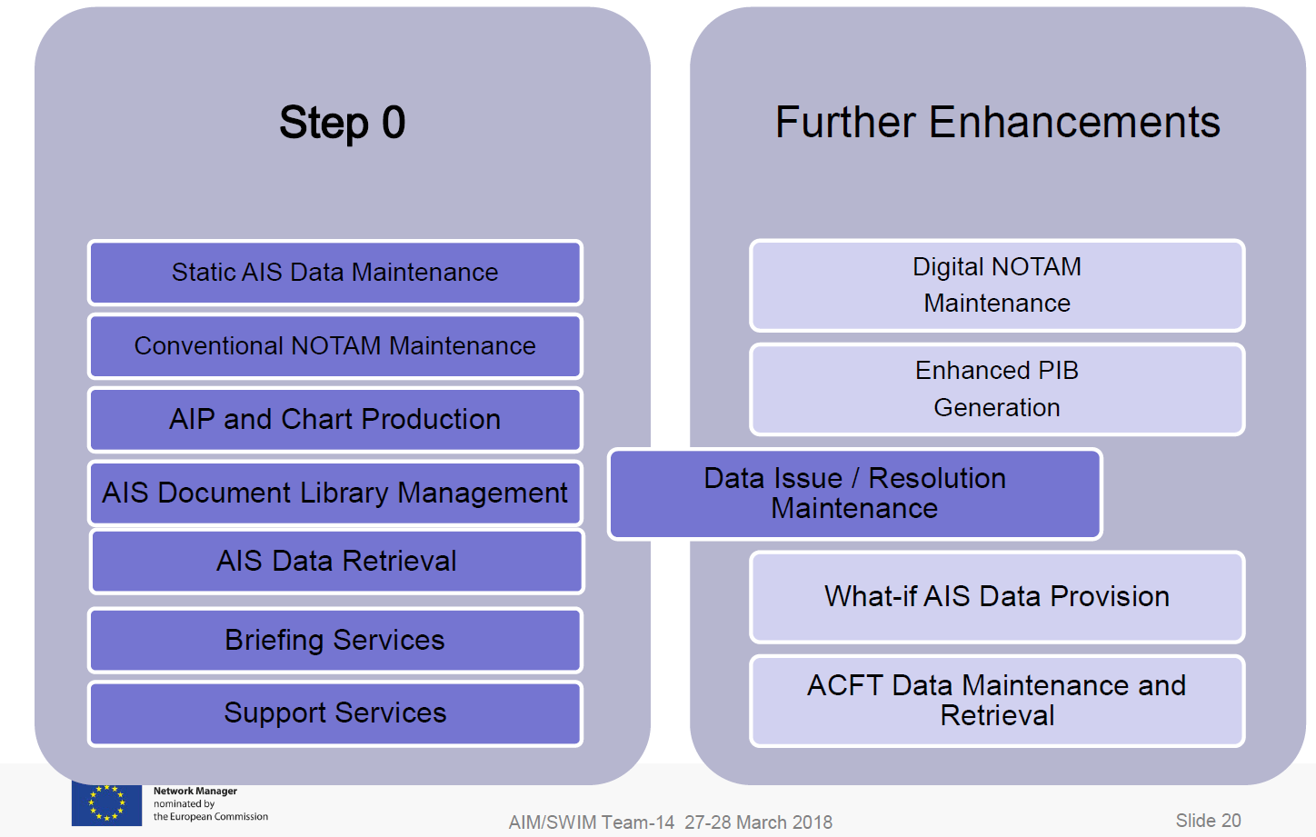
EUROCONTROL - EAD evolution (eEAD)

Slide 8
Agenda
Brainstorming – how to encourage the Digital NOTAM implementations around the world
  ICAO Annex 15 (16th edition) – “placeholder” for Digital NOTAM
  ICAO/IMP – NOTAM revision plans
  Digitally enhanced briefing concept (SESAR ePIB) as an end user application based on Digital NOTAM
  Proposed actions

Slide 9
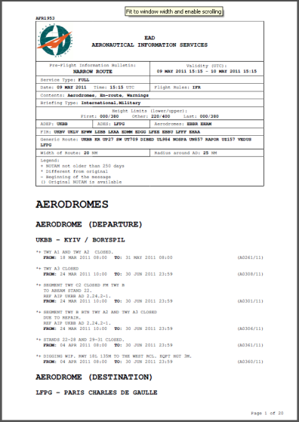
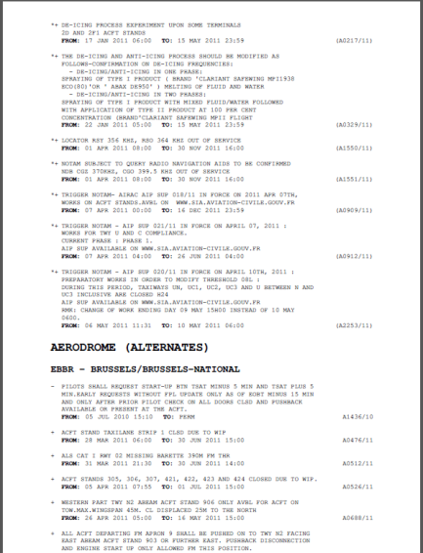
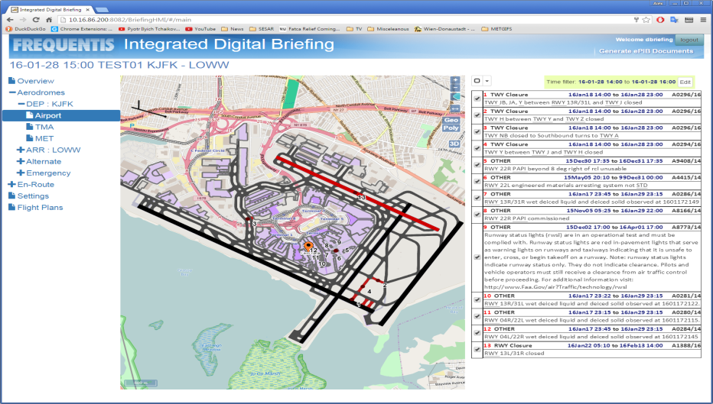
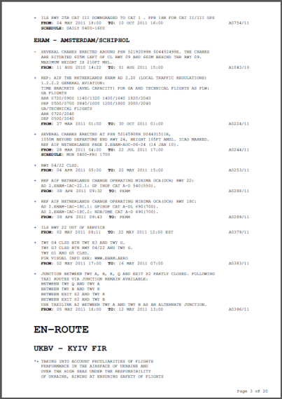
Digitally enhanced briefing (ePIB)
SESAR Project (“Solution #34”)

Slide 10

Digitally enhanced briefing (ePIB)

Slide 11
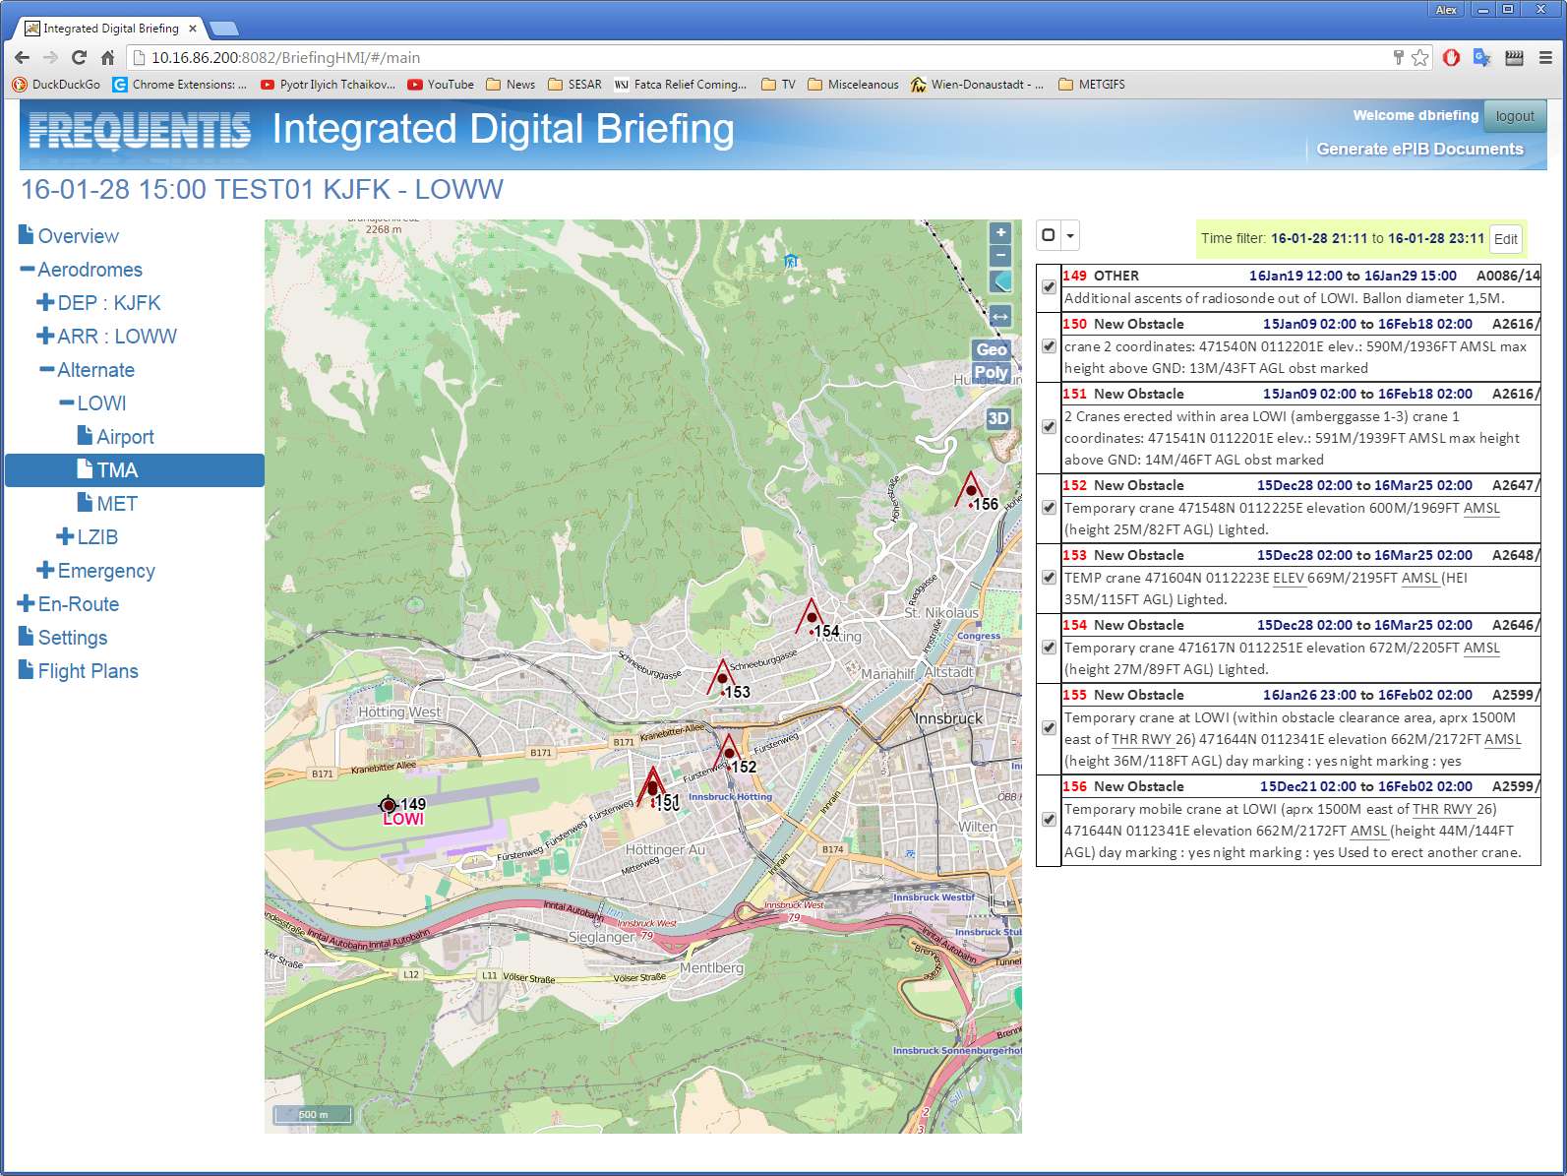
Digitally enhanced briefing (ePIB)

Slide 12
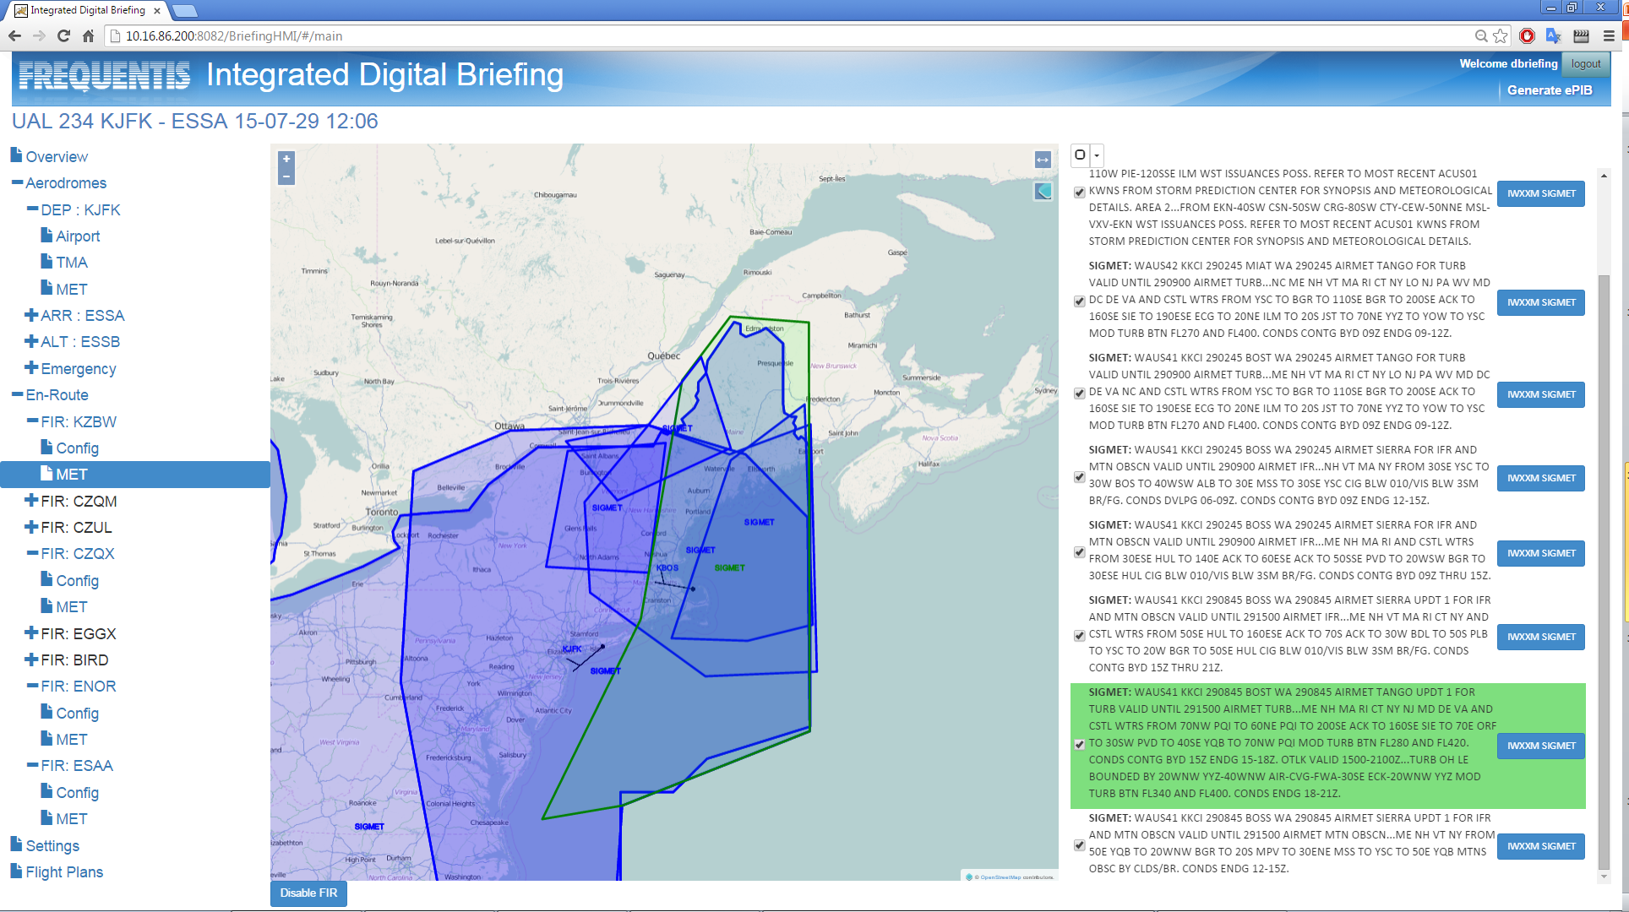
Digitally enhanced briefing (ePIB)

Slide 13
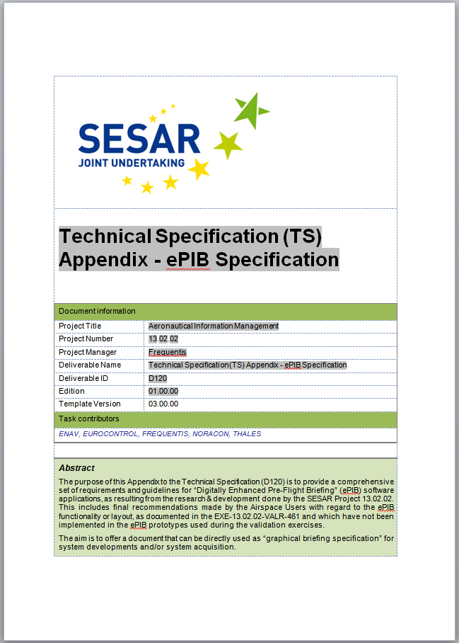
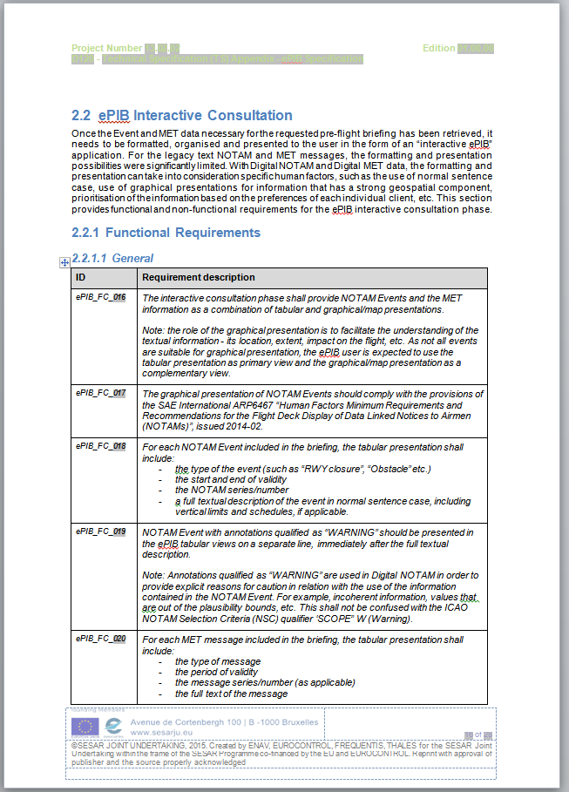
ePIB Specification

Slide 14
Initial ePIB implementations
Can be limited to aerodrome data
  Require limited airport mapping data
… or limited to VFR data
  current airspace situation
Can use a mix of NOTAM and Digital NOTAM
  Non-digital NOTAM coded as “OTHER” events
Can be made available “for awareness”
Support by industry?

