Slide 1
DECEA
NOTAM Project
Digital NOTAM Implementations
Sept. 20th 2018

Slide 2
Presentation Overview
DECEA Intro
Context of the Project
General Description
Milestones vs Achievements
Software Solution Presentation
Static Data Baselines for NOTAM Management
Data Origination Digitalization
Data Distribution Channels
Client Outcomes and Solutions
All rights reserved

Slide 3
DECEA (Department of Airspace Control)
DECEA is the State Department of Airspace Control in Brazil;
It is a part of Brazilian Air Force;
It is responsible to mantain control of the Brazilian Airspace, providing air navigation services and allowing air traffic flow maintenance, in more than 22.000.000 Km^{2.}
It is the sole provider of Aeronautical Information in Brazil, most of them is available on www.aisweb.aer.mil.br;

Slide 4
DECEA (Department of Airspace Control)
To give a glimpse of how many information Brazil (DECEA) and IDS must deal, on more than 22.000.000 km² of airspace control responsability area, there are more than 3600 aerodromes. Of the 3600, more than 135 are IFR homologated.
There are more than 1900 NOTAM published regarding Brazilian Airspace.

Slide 5
Why DECEA chose IDS Dynamic Data management ?
To complete the existing AIM-BR system
To continue cooperating with a reliable partner
To grant its own roadmap from AIS to AIM
To keep dynamic and static data in the core of an integrated system
To comply with data quality requirements
To innovate with a Digital NOTAM System in Ops
To be ready for today’s and tomorrow’s aviation

Slide 6
AIM-BR System
AIM-BR
Is the centralized Aeronautical Data Management System provided by IDS Corporation
Is aimed to the generation of Aeronautical Publications (AIP, Amdt, SUP, AIC) – Charts (ENRC, ARC, Aerodromes,...) and to the design of Flight Procedures
Has resulted into the need to establish harmonized operating procedures for:
Processing and managing NOTAM Information in an integrated environment
Digitalization of managed information
Answering to the increasing demands for the enhanced quality and integrity of aeronautical information and data
All rights reserved

Slide 7
(D)-NOTAM System
(D)-NOTAM System
Extends the AIM-BR System to harmonized procedures for AIS Dynamic Data
Provide an operating and integrated Solution for AIS and NOF centres
Provide a Dual Environment for NOTAM generation:
ICAO Compliant Web Forms for NOTAM and Proposals
Digital NOTAM (AIXM5.1 Event Packages)
Harmonize the Aeronautical Data Process also for Dynamic Data
All rights reserved

Slide 8
(D)-NOTAM System Milestones
03/2015
Site Survey and Solution Design
Factory Acceptance Test
Data Migration
System Instl and Conf
Site Acceptance Test in Rio de Janeiro
Hardware Acceptance Test phase
Software Qualification Test phase
Parallel Running in NOF (ICA, RJ)
Switch Over into operations
Site Acceptance Test for Regional Sites
06/2015
12/2015
06/2017
08/2018
All rights reserved

Slide 9
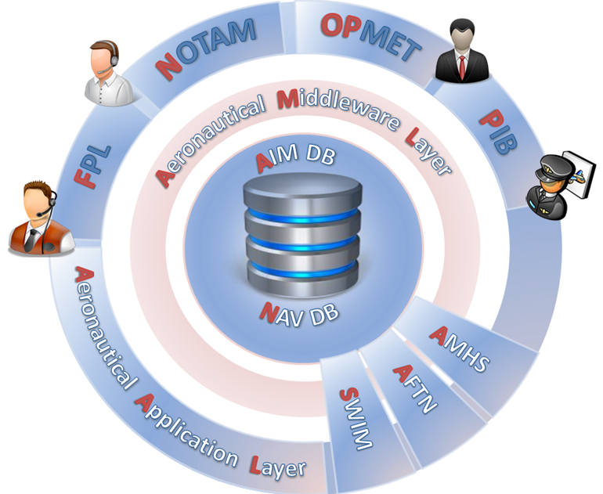
Focus on technical Solution
IDS CRONOS
is the provided Software Solution for the management of AIS Dynamic Data
supports provisioning of digital NOTAM packages
includes all the Aeronautical Events contained into the D-NOTAM Event Specification – increment 1
Users can manage dynamic aeronautical data distributed over traditional networks, such as AFTN or AMHS
This includes full support for NOTAM (traditional messaging) over AMHS
Digital NOTAM AIXM51 packages are distributed via REST Services or AMHS Services for the ICAO NOTAM content
All rights reserved

Slide 10
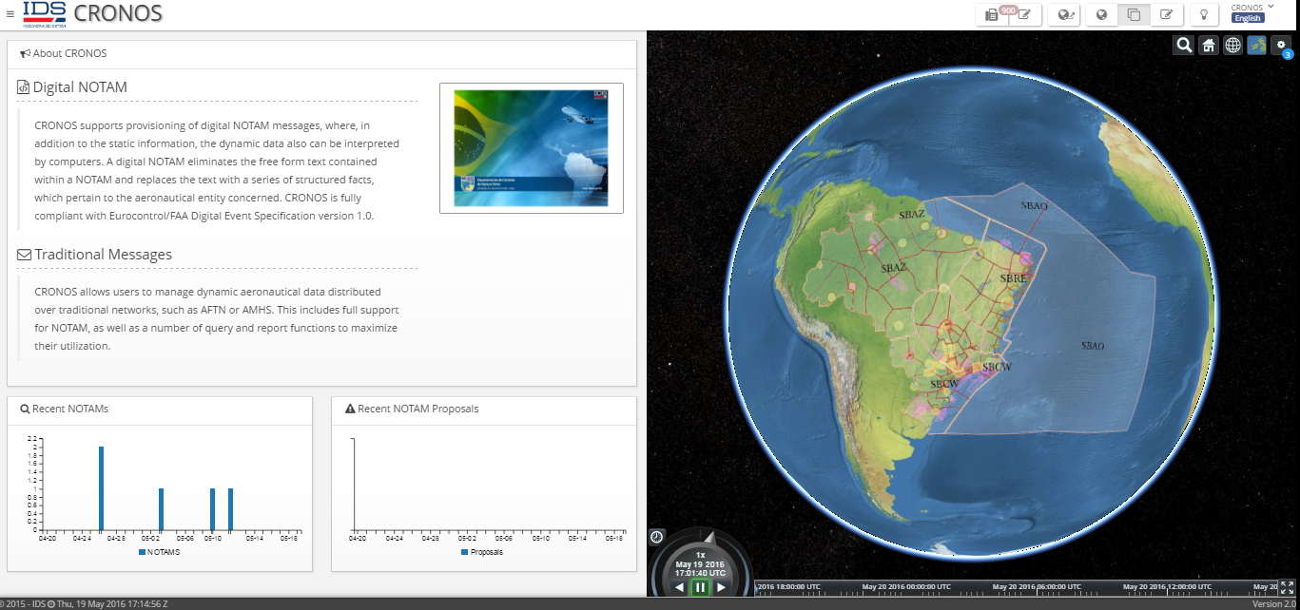
IDS CRONOS
Systems
Users
External
Systems
Dual environment for NOTAM and Digital NOTAM
cronos-portal-webservice
D-NOTAM
REST
WMS
WFS
NOTAMs
AimDB
NavDB
AeroDB
Charts
AMHS Interface
SDO
(NTL)
Publications
Procedures
Synch
Aeronautical Static Data are fed by SDO synch & SDO Importer (AIXM45)
SDO Import
(INTL)
(AIXM45)
(D)-NOTAM system
AIM-BR system
All rights reserved

Slide 11
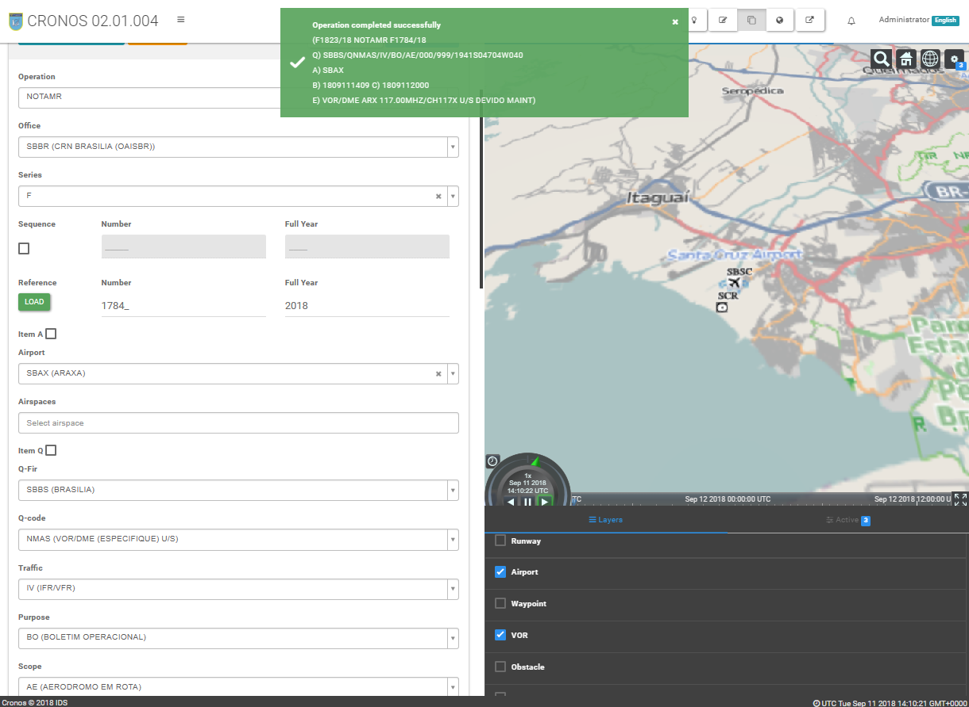
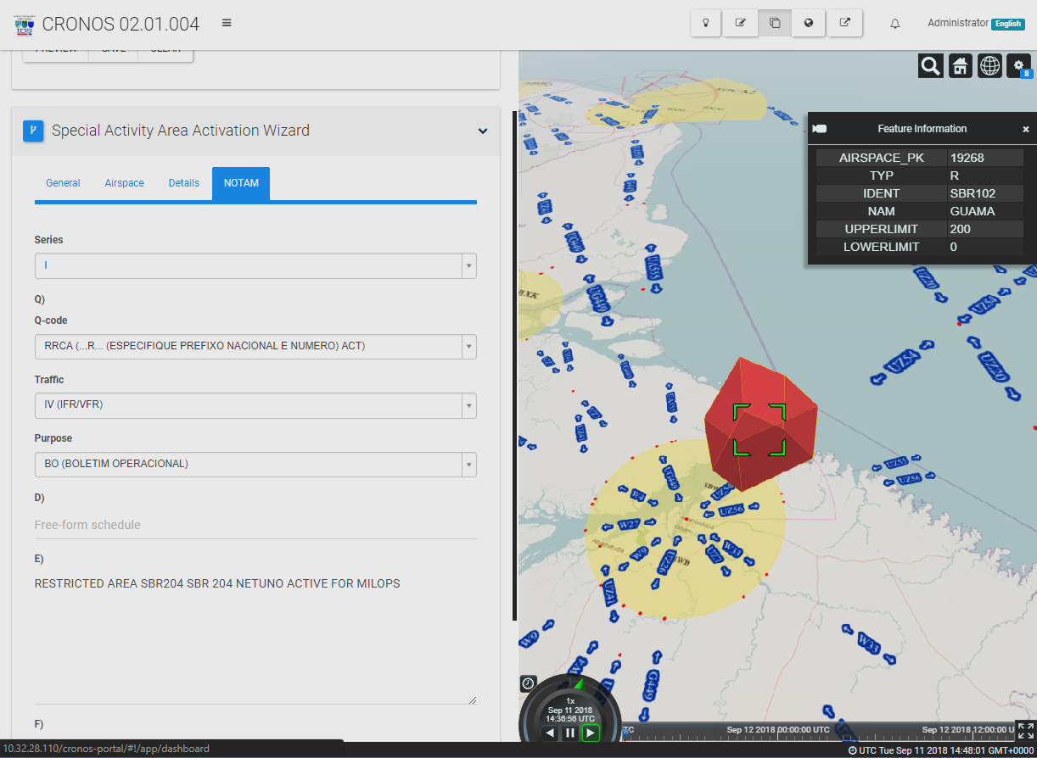
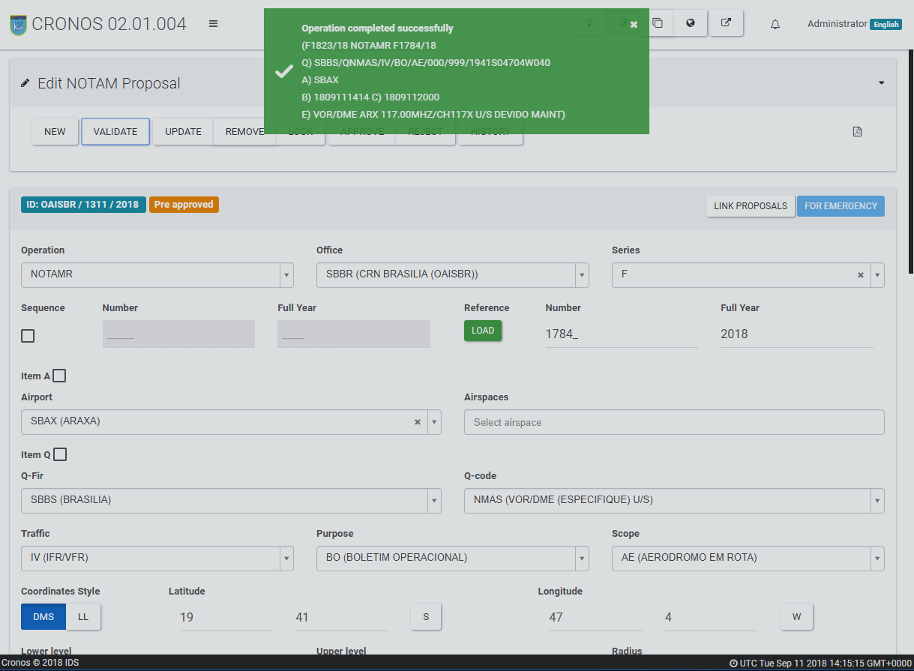
IDS CRONOS
NOTAM proposal approval process
NOTAM distribution over AMHS
NOTAM N,R,C
TAM Query and Reporting
Traditional ICAO NOTAM Form
Message Templates
Aeronautical Event approval Process
Digital NOTAM Distribution over AMHS (ICAO Format) and REST Services (Aeronautical Package)
Events Query and Reporting
Wizard-driven creation process
All rights reserved

Slide 12
(D)-NOTAM Capabilities

Slide 13
SDO Data Baseline(s)
All rights reserved

Slide 14
Project Outcomes
From Data Origination, to Information Distribution
Digitalization of the Information by Regional Sites
Innovation by implementing D-NOTAM platform
Fulfillment of Data Integrity and Data Quality Requirements
Efficient Tracking of main activities on aeronautical data
All rights reserved

Slide 15
Client Satisfaction
Regarding capabilities and performance of IDS CRONOS, the expected achievements have been accomplished
Although, in terms of D-NOTAM, still a few number of events has been formalized (11)
More, none of the countries, especially in South and Central America, is using D-NOTAM
All rights reserved

Slide 16
Client Satisfaction
It is possible to obtain a fast and reliable transmission of D-NOTAM, but we still need to conduct some tests regarding proper reception of the information by the user.
Regarding the operational environment of CRONOS for the technical operator, it is satisfactory, allowing fast and reliable expedition of NOTAM.
All rights reserved

Slide 17
Client Solutions
In order to reduce the total amount of PERM NOTAM, some actions are being conducted in paralell of CRONOS. It is part of the project of GEILOC and Digital ROTAER (ROTAER is not an ICAO publication. It is more likely FLIP by NGA, in USA). Most of the PERM NOTAM are expedited because of an activation of a aerodrome.
All rights reserved

Slide 18
Client Solutions
In order to create another way to distribute Aeronautical Information throgh official website portal, DECEA developed the API-AISWEB to allow NOTAM to be consumed by users in a structured way.
As a roadmap, soon it will be available on AISWEB D-NOTAM for tests.
All rights reserved

Slide 19
Obrigado

