Slide 1
Advancing Digital NOTAM implementation
Olga Mashinskaja
AIM expert, Estonian Air Navigation Services

Slide 2
Introduction
1993 - Estonian NOTAM Office was established as a part of Integrated Briefing Office
of Estonian AIS – it is a part of Estonian Air Navigation Services.
1993-2000 – A teletypewriter was used for NOTAM distribution
2000 - start of the first NOTAM Office system
2009 – Estonian AIS started a Project with Frequentis Comsoft to supply advanced AIM system. The heart of the system is based on CADAS-AIMDB Aeronautical Database fully implementing AIXM 5 standard
2012 - a new system for IBOF including NOTAM Office based on Frequentis Comsoft CADAS product suite
2012 - migration to EAD as Data Provider (NOTAM).
2018 – ADQ compliant Work Flow Management system implementation project with Frequentis Comsoft, facilitating NOTAM proposal submission, control, management
ICAO AIS to AIM Roadmap released
1st AIXM 5.1 database of Europe operational in Estonia

Slide 3
Need for digital NOTAM
Last minute aeronautical information update means “NOTAM” ICAO definition of NOTAM: A notice distributed by means of telecommunication containing information concerning the establishment, condition or change in any aeronautical facility, service, procedure or hazard, the timely knowledge of which is essential to personnel concerned with flight operations
ICAO AIS to AIM Roadmap P-21 — Digital NOTAM The digital NOTAM will be defined as a data set that contains information included in a NOTAM in a structured format that can be fully interpreted by a computer system for accurate and reliable updates of the aeronautical environment representation both for automated information equipment and for aviation personnel
Instead of creating and maintaining individual text NOTAM with complex release processes, the focus is on the maintenance and integrity of the aeronautical data

Slide 4
Need for digital NOTAM
The provision of aeronautical information today is mainly focused on the requirements of pre-flight briefing.
The provision of aeronautical information tomorrow will address the requirements of all components of the ATM system for all phases of flight.
Amdt 40 to Annex15 Data set updates When temporary changes of short duration are made available as digital data (Digital NOTAM), they should use the same aeronautical information model as the complete data set.
Digital NOTAM Event Specification – Increment 1 The Digital NOTAM Event Specification defines the rules for harmonised encoding as AIXM data sets (version 5.1 or later).

Slide 5
Advancing digital NOTAM implementation
In 2017 dNOTAM project was started with Frequentis Comsoft. A NOTAM event commonly used by EANS was selected as proof of concept.
Further dNOTAM event configurations in preparation.
Q-code | DNOTAM scenario
RTCA | SAA.ACT / SAA.NEW
RDCA | SAA.ACT / SAA.NEW
Q-code | DNOTAM scenario
OBCE | OBS.NEW

Slide 6
System Overview
Data Originator
EANS
EUROCONTROL
verify,
approve or reject
create
propose
CADAS-AIMDB
ICAO Txt NTM
CADAS-IMS
ICAO Txt NTM
EAD
NOTAM
Data
reject
NTM No
NTM No
AIXM 5 Data Management
ICAO Text NOTAM
Management
WFM Context

Slide 7
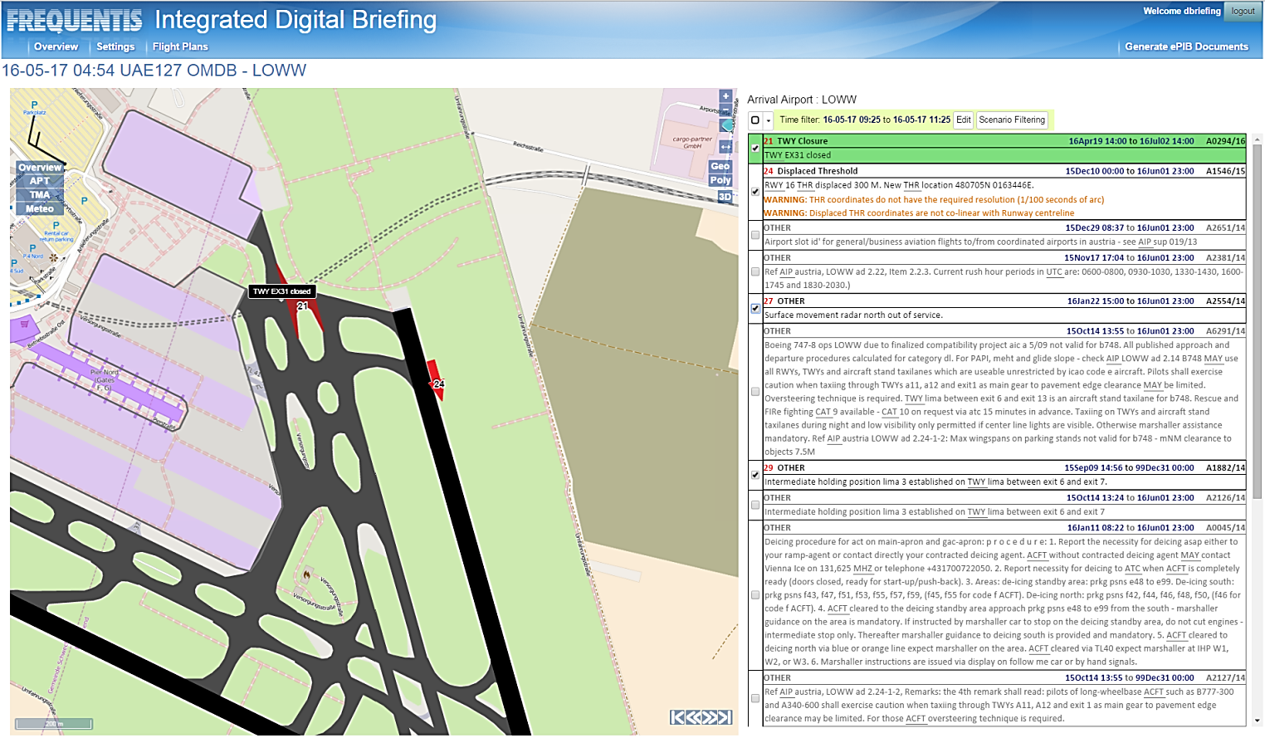
Digital Briefing

Slide 8
Impact and challenges
STAFF COMPETENCIES Training for NOF staff – Basic understanding of AIXM and temporality model, Data base Cooperation and training for Data Originators
Transition period while all Data Originators are trained NOF workload increases for the transition period
Need for Guidance Materials-> different from OPADD, support from Eurocontrol -> lessons learnt feedback-> further cooperation with Eurocontrol

