Slide 1
FAA Federal NOTAM System (FNS)
System Status
AIXM Digital NOTAM Coding FG
Trish Gay, FAA
Hoon Kang, FAA
Marina Chumakov, CNA
September 20, 2018

Slide 2
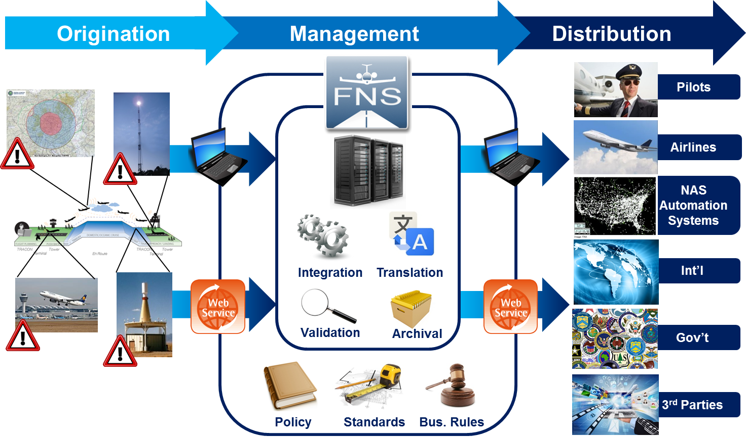
NOTAM Modernization
Web services for collecting and
disseminating digital NOTAM data

Slide 3
NOTAM Origination
Legacy NOTAM sources
Web-applications for originating digital NOTAMs
  NOTAM Manager for airports, technical operations, and procedures and charting
  eNOTAM II (ENII): tower light operations, field conditions
NOTAM Origination Service (NOS)
  AIXM 5.1 Web service for origination of digital NOTAMs
    Tower light operators with third-party software submit directly to FNS
    Automated connection for technical operation NOTAM submission (Future)

Slide 4
FNS NOTAM Distribution Service (FNS-NDS)
FNS uses web services for collecting and disseminating digital NOTAM data

Slide 5





Request/Response Service
Request
Request
Response
Response
Consumer
SWIM
FNS-NDS
Example Query Types:
Bulk
all active NOTAMs of specific types (e.g., Domestic, Int’l)
Delta
changes to NOTAMs in last X minutes
Geographic
active NOTAMs with X radius of location or coordinates
Location
active NOTAMs with NOTAM location id
Free Text Search
active NOTAMs that match text string
Publish/Subscribe Service
Topic: All
NOTAMs
Publish
Subscribe
Other
Topics
Publish
Push
Consumers
SWIM
FNS-NDS
Loose coupling between provider and consumer; allows scalability

Slide 6
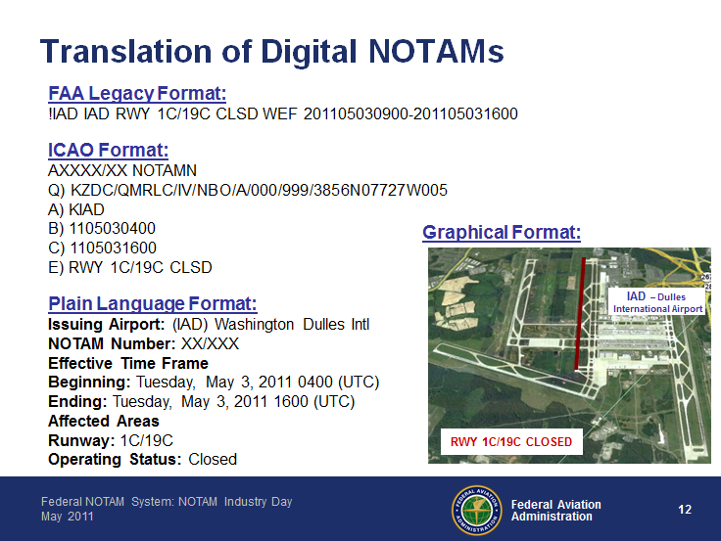
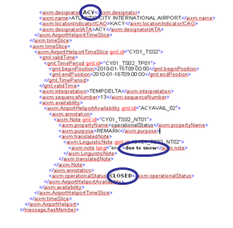
FAA Event Scenarios
NOTAM scenarios were developed through:
  FAA historical NOTAM analysis to identify most common scenarios
  Collaboration with Digital NOTAM Focus Group in AIXM Digital NOTAM Event Specification development
Scenarios that overlap with NOTAM Event Specification include additional detail or data elements
Additional scenarios that cover FAA-specific NOTAMs
NOTAM text translations in FAA legacy, ICAO, and plain text format
Uses the same AIXM encoding as Digital NOTAM Event Specification

Slide 7
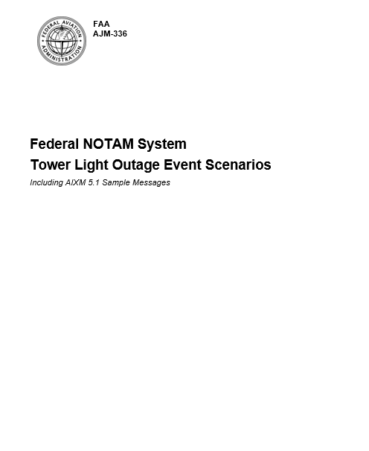
FAA Event Scenario Documentation
Introduction to the Federal NOTAMs System (FNS)
Defining an Event Scenario
Scenario Details
Q Codes and Series
Business Rules
  Template Business Rules
  Policy Business Rules
  Data Encoding Business Rules
Sample AIXM Message
Translation Templates
  FAA
  ICAO E Line
  Plain Text

Slide 8
Example Event Scenario Details
    Scenario Details
TABLE 1.1
Permanent Obstruction Mapping Details
Attribute | Value
Description | Specify details of an Obstacle Light Status
Maps to Keyword | OBST
Feature Type Id | Vertical Structure
Feature XPath | aixm:VerticalStructure
AIXM Mapping Diagram | Obstacle/Vertical Structures
Start ASAP | Yes
FAA Scenario Identifier | 1005
    Affected Obstruction
Description: Identifies the obstruction.
Source: User-selected (see below).
TABLE 1.2
Affected Obstruction
Attribute | Value
AIXM Path (UML) | ObstacleArea (feature)/ obstacle (xlink:href)
AIXM Element XPath | ObstacleArea/ timeSlice/ ObstacleAreaTimeSlice [interpretation TEMPDELTA]/ obstacle xlink:href
AIXM Path (UML) | VerticalStructure (feature) – designator/name (attribute)
AIXM Element Xpath | VerticalStructure/ timeSlice/ VerticalStructureTimeSlice [interpretation SNAPSHOT]/ name VerticalStructure/ timeSlice/ VerticalStructureTimeSlice [interpretation SNAPSHOT]/ part/ VerticalStructurePart/ designator
AIXM Mapping | Class: VerticalStructure
Datatype | TextNameType TextDesignatorType

Slide 9
Event Scenario Details
    Status [operationalStatus]
Description: A code indicating the operational status of the lighting. For example, serviceable, unserviceable, work in progress, etc.
Source: User-selected (required)
TABLE 1.3
Obstacle Lighting Operational Status
Attribute | Value
AIXM Path (UML) | VerticalStructure(feature)/ VerticalStructureLightingStatus(object)
AIXM Element Xpath | VerticalStructure/ timeSlice/ VerticalStructureTimeSlice/ [interpretation TEMPDELTA]/ lightingAvailability/ VerticalStructureLightingStatus/ status
AIXM Mapping | Class: VerticalStructureLightingStatus
Enumeration | CodeStatusOperationsType
 | AIXM | Translations
 | UNSERVICEABLE | ICAO | OUT OF SERVICE
 |  | FAA | OUT OF SERVICE
 |  | Plain Text | Out of service
    Data Encoding Business Rules
For verticalStructure, the SNAPSHOT should contain the ASR number and/or ASN number of the obstacle, the type of structure, the baseline lighting expectation, the height of the obstruction in AGL (verticalExtent), the elevation of the obstruction in MSL (verticalExtent plus elevation) and a tag that points to the nearest airport.
The AIXM Message need only to have the coordinates of the verticalStructure and of the Airport. The direction and distance can be calculated by these coordinates.
For verticalStructure, the TEMPDELTA should contain the status of the lights.
The latitude and longitude must be converted to decimal for the AIXM Message.

Slide 10



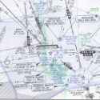

FAA Scenarios Deployed
 | Type of NOTAM | # of Scenarios | Status
 | Airport Operations | ~70 | Operational
 | Technical Operations | ~30
 | Obstacle Lighting | 2
 | Instrument Flight Procedures | 10
 | Military | ~70
Upcoming Release – Late Fall 2018
Enhancements and bug fixes for the FNS-NDS

Slide 11
How to connect
System Development and Testing
Operational
Test Agreements with FNS Program Office
Coordinate with and connect to SWIM
1
2
3
4

Slide 12
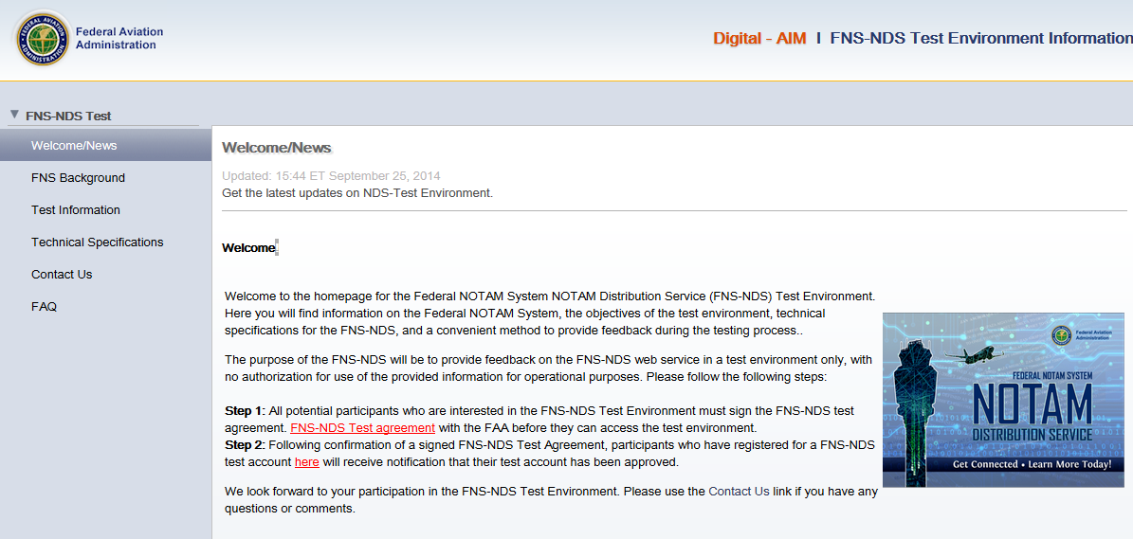
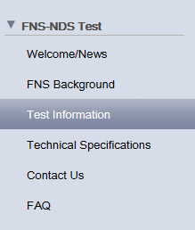
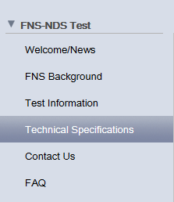
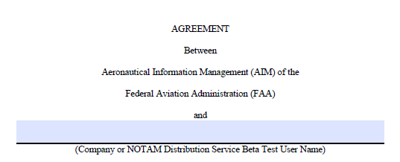
Agreements/Development
http://notamdemo.aim.nas.faa.gov/ndshome/
Access to all FNS-NDS technical documents:
Web Service Requirements Document
Web Service Design Document
Web Service Definition Language
… and more!
2
1

Slide 13
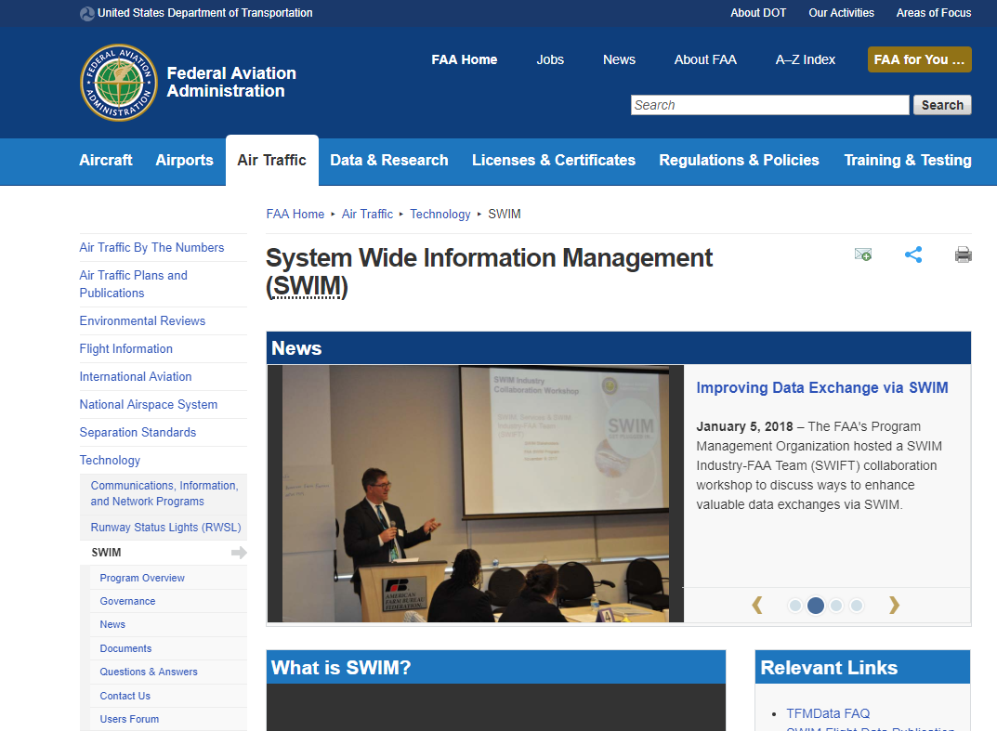
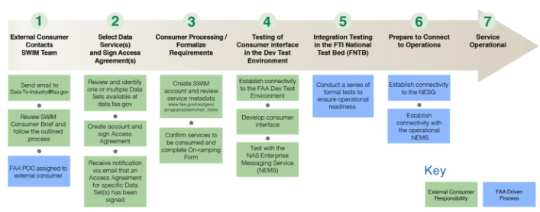
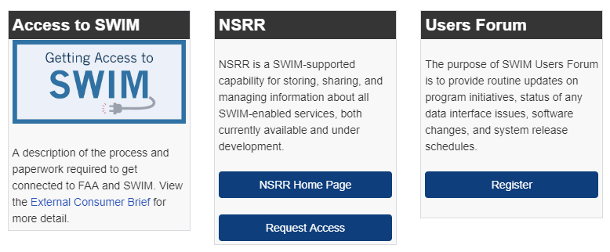
SWIM Coordination
3
Consumer-driven process
2-6 months
http://www.faa.gov/nextgen/programs/swim/

Slide 14
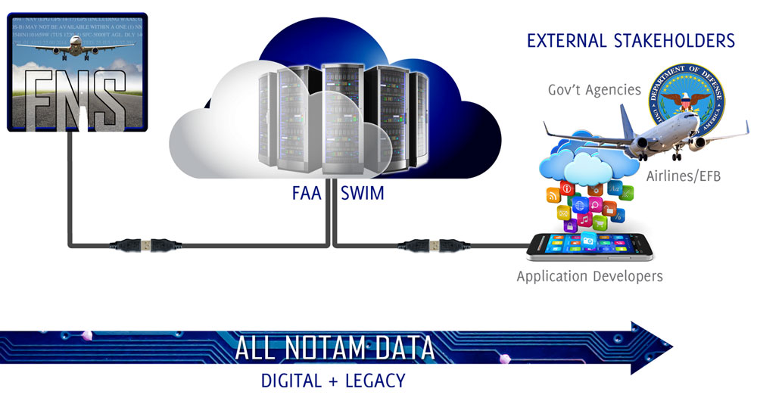

Operational Access
4
Access to FNS-NDS:
Complete all system testing with SWIM and FNS
Coordinate with stakeholders
Begin receiving digital NOTAMs from FNS!

Slide 15
Future Enhancements to the FNS
Updates to contractions to further align with ICAO
7930.2S policy updates
FNS-NDS updates
Automated connection to Technical Operations ticket data
Construction Notice Diagram automation
Further Takeoff and Landing Performance Assessment (TALPA) alignment
DOD NOTAM Manager enhancements
Query optimization, database archiving, hardware updates
KEY
Policy
Fixes
Enhancements

Slide 16

Questions
Contact FNS:
Trish Gay
trish.gay@faa.gov
FNS Program Manager
Hoon Kang
hoon.kang@faa.gov
FNS Program Manager
Marina Chumakov
Marina.ctr.chumakov@faa.gov
CNA, FNS Support

